Slide 1
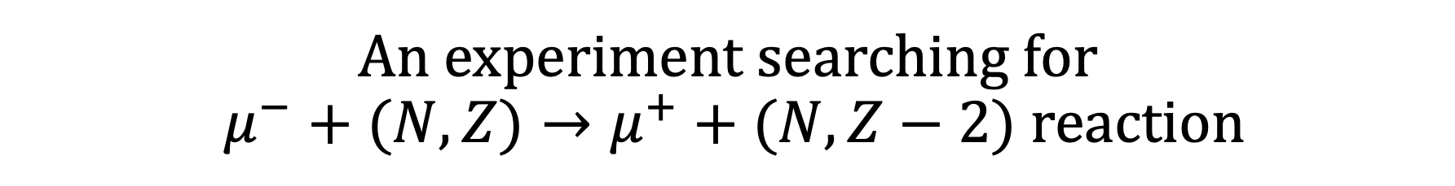
An experiment searching for $μ^{−}+(N,Z)→μ^{+}+(N,Z−2) reaction$
Osaka university department of physics Kuno group
fourth year students graduation research
Yuya Higuchi, Keisuke Yoshida, Yoshiki Nishimura
Notes:
タイトル

Slide 2
Contents
Purpose of experiment
Principal of experiment
Choice of target
Equipment
Expected spectrum
Background
Summary
Notes:
アウトラインを示す

Slide 3

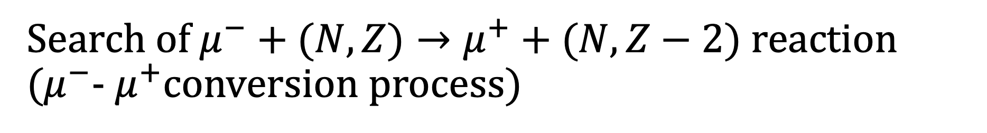




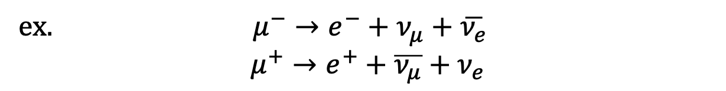
Purpose of experiment
Search of $μ^{−}+(N,Z)→μ^{+}+(N,Z−2)$ reaction ($μ^{−}$- $μ^{+}$conversion process)
Lepton number … Lepton are parameterized with quantum number.
In standard model , lepton number is conserved.
ex. $μ^{−}→e^{−}+ν_{μ}+\overline{ν_{e}}$ $$μ^{+}→e^{+}+\overline{ν_{μ}}+ν_{e}$$
p
n
However, this reaction . . .
$$μ^{−}$$
$$ν_{μ}$$
 | Before reaction | After reaction
Lepton number | +1 | -1
$$ν_{μ}$$
$$μ^{+}$$
p
n
→Lepton number violation
Feynman diagram of $μ^{−}– μ^{+}$ conversion
Notes:
レプトンナンバーとは
lepton flavor は標準理論では保存 （代表例）
ニュートリノはマヨラナか？
ミューオンで行うメリット
さんしよう

Slide 4



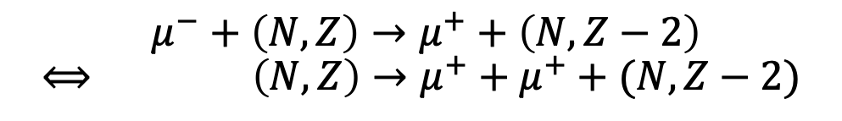


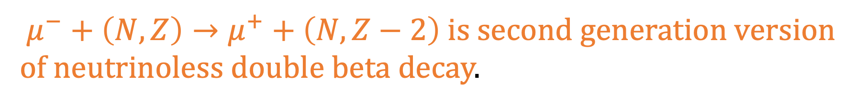









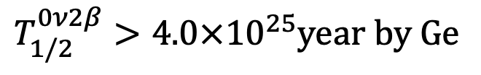
Relation to the other processes
p
n
p
n
$$μ^{−}+\left(N,Z\right)→μ^{+}+\left(N,Z−2\right)$$
$$⟺ \left(N,Z\right)→μ^{+}+μ^{+}+(N,Z−2)$$
$$μ^{−}$$
$$μ^{+}$$
$$ν_{μ}$$
$$ν_{μ}$$
$$ν_{μ}$$
$$⇒$$
$$ν_{μ}$$
$$μ^{+}$$
$$μ^{+}$$
p
n
p
n
$∙\left(N,Z\right)→e^{−}+e^{−}+\left(N,Z+2\right) ⋯$ neutrinoless double beta decay
n
p
$T_{1/2}^{0ν2β}>4.0×{10}^{25}$year by Ge
$$W^{−}$$
$$e^{−}$$
$$\overline{ν_{e}}$$
$$\overline{ν_{e}}$$
$$e^{−}$$
$$W^{−}$$
Feynman diagram of neutrinoless double beta decay
n
p
$μ^{−}+\left(N,Z\right)→μ^{+}+\left(N,Z−2\right)$ is second generation version of neutrinoless double beta decay.
$$∙ K^{+}→μ^{+}+μ^{+}+π^{−} ⋯ decay of K meson <8.6×{10}^{−11}$$
Notes:
始状態を終状態に持ってきたイラストをのせる
第二世代と第一世代の違いを述べる
Sクオークがあるかないか …今後の検討
それぞれB.R.を書いておく referenceも

Slide 5
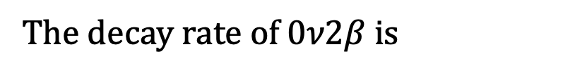
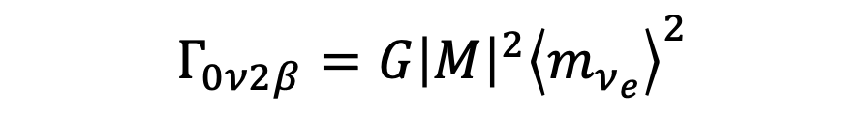
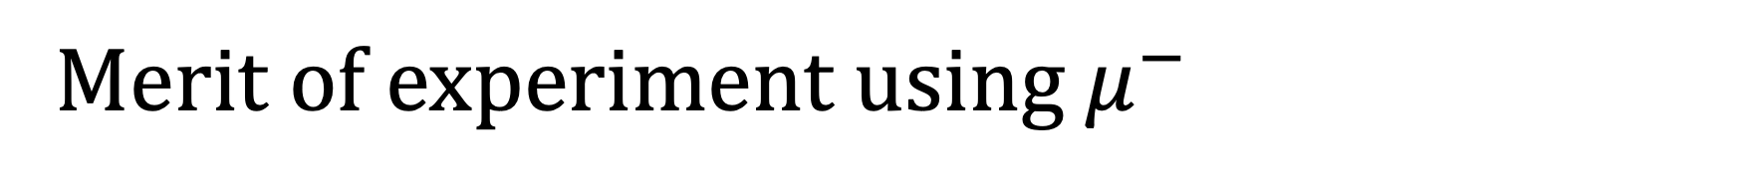

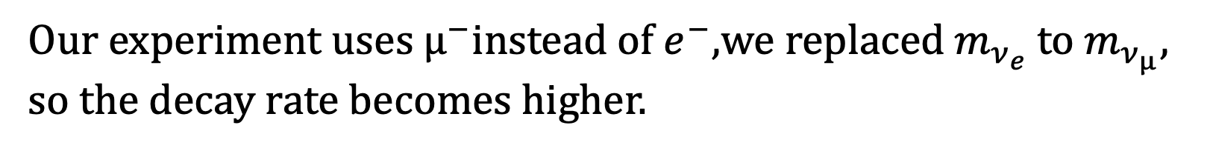

Merit of experiment using $μ^{−}$
p
n
n
p
$$μ^{+}$$
$$W^{−}$$
$$e^{−}$$
$$ν_{μ}$$
$$\overline{ν_{e}}$$
$$ν_{μ}$$
$$\overline{ν_{e}}$$
$$e^{−}$$
$$μ^{+}$$
$$W^{−}$$
p
n
p
n
The decay rate of $0ν2β$ is
$$Γ_{0ν2β}=G{\left|M\right|}^{2}{\left\langle m_{ν_{e}}\right\rangle }^{2}$$
$m_{ν_{e}}$ : mass of electron neutrino
G : phase space factor M : matrix element
Our experiment uses $µ^{−}$instead of $e^{−}$,we replaced $m_{ν_{e}}$ to $m_{ν_{µ}}$, so the decay rate becomes higher.
In order to know whether neutrino is Majorana particle, we would be better to use heavier neutrino.

Slide 6


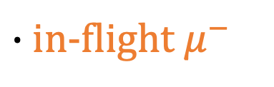
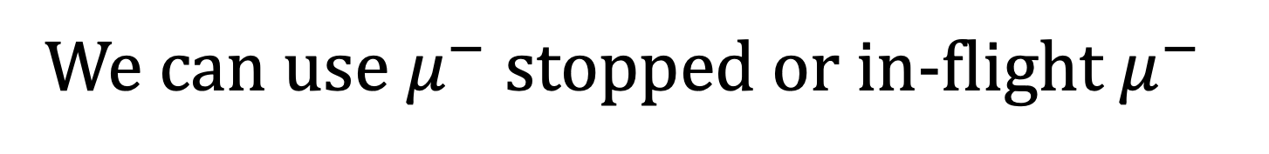




We can use $μ^{−}$ stopped or in-flight $μ^{−}$
$∙{ μ}^{−}$ stopped
$$μ^{−}$$
$$μ^{+}$$
atomic nucleus
$$μ^{−}$$
(N,Z)
(N,Z-2)
$∙$in-flight $μ^{−}$
atomic nucleus
$$μ^{−}$$
$$μ^{+}$$
(N,Z)
(N,Z-2)

Slide 7
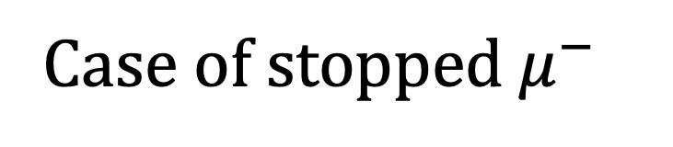
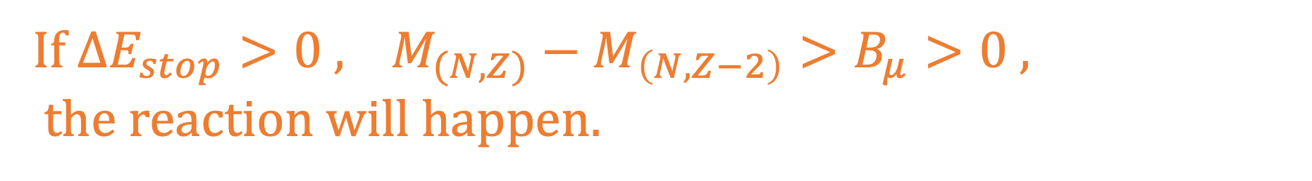
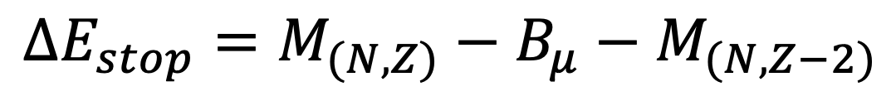
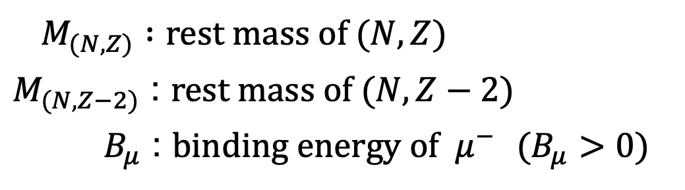
Case of stopped $μ^{−}$
${ΔE}_{stop}$ : emitted energy through the reaction using $μ^{−}$ stopped
$${ΔE}_{stop}=M_{(N,Z)}−B_{μ}−M_{(N,Z−2)}$$
$M_{(N,Z)} :$ rest mass of $(N,Z)$
$M_{(N,Z−2)}$ : $rest mass of (N,Z−2)$
$B_{μ}$ : $binding energy of μ^{−}$ $(B_{μ}>0)$
If ${ΔE}_{stop}>0$, $M_{(N,Z)}−M_{\left(N,Z−2\right)}>B_{μ}>0 ,$
the reaction will happen.
But materials which satisfy these conditions are radionuclides, so we can’t use them.
ex. ⁴⁴Ti , ⁷²Sr ⁴⁴Ti…$2cm×2cm×100μm 5.0×{10}^{11}$Bq
Notes:
実験にはstopeed とin-flightがあるという前置き
Radionuclideの例をのせる 放射能ものせ、実験に使用できないことを裏付ける referenceも
イラストを描く

Slide 8
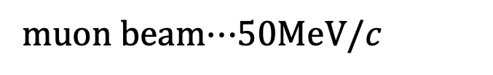
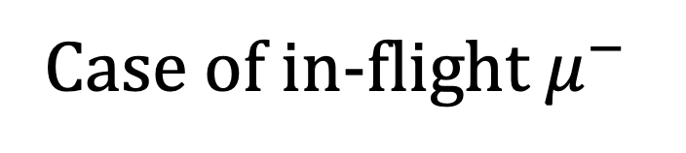
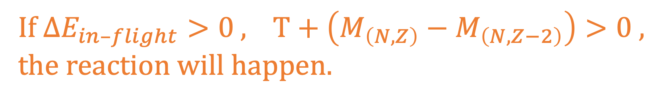
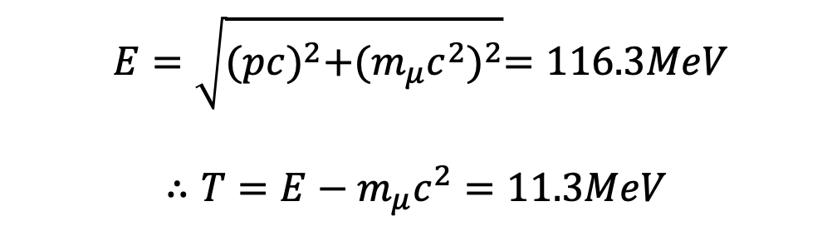
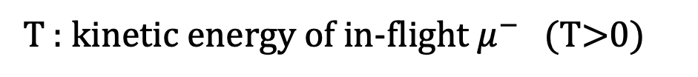
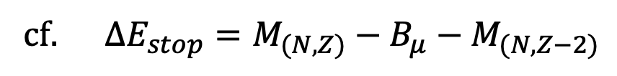
Case of in-flight $μ^{−}$
We can’t use $μ^{−}$stopped, so we decided to use in-flight $μ^{−}.$
${∆E}_{in–flight}$ : emitted energy through the reaction using in-flight $μ^{−}$
$${∆E}_{in–flight}=M_{(N,Z)}+T−M_{(N,Z−2)}$$
T : kinetic energy of in-flight $μ^{−}$ (T>0)
cf. ${ΔE}_{stop}=M_{(N,Z)}−B_{μ}−M_{(N,Z−2)}$
$$E=\sqrt{{(pc)}^{2}+{(m_{μ}c^{2})}^{2}}=116.3MeV$$
$$∴T=E−m_{μ}c^{2}=11.3MeV$$
muon beam$⋯$50MeV/$c$
If ${ΔE}_{in–flight}>0$, $T+\left(M_{\left(N,Z\right)}−M_{\left(N,Z−2\right)}\right)>0$ , the reaction will happen.
Notes:
Stoppedでできないからin-flightを検討した
ΔEの対比
イラストを描く

Slide 9
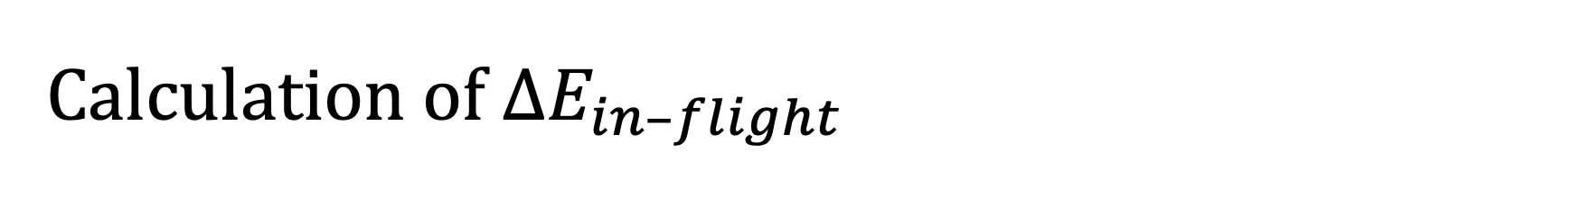
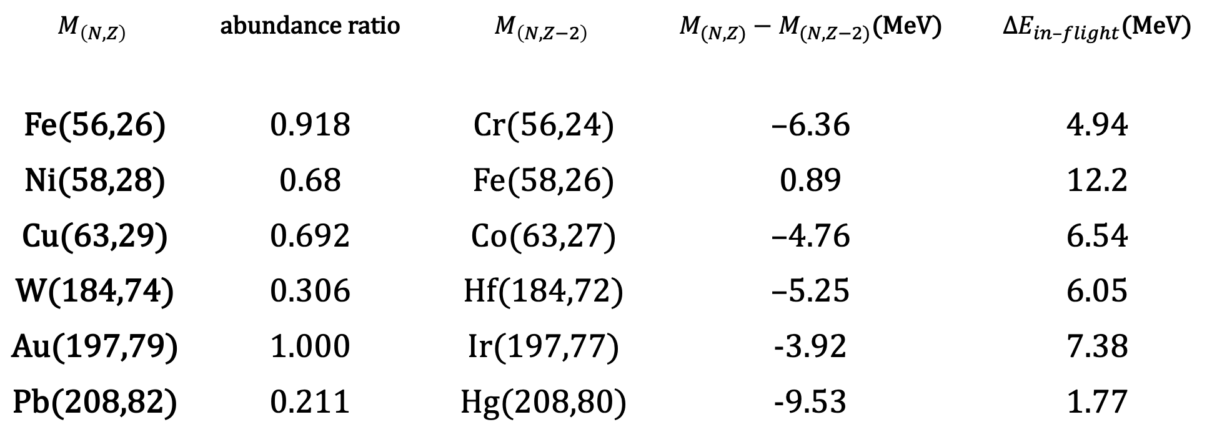
Calculation of ${ΔE}_{in–flight}$
$$M_{\left(N,Z\right)}$$ | abundance ratio | $$M_{\left(N,Z−2\right)}$$ | $M_{(N,Z)}−M_{(N,Z−2)}$(MeV) | $∆E_{in–flight}$(MeV)
Fe(56,26) | 0.918 | Cr(56,24) | –6.36 | 4.94
Ni(58,28) | 0.68 | Fe(58,26) | 0.89 | 12.2
Cu(63,29) | 0.692 | Co(63,27) | –4.76 | 6.54
W(184,74) | 0.306 | Hf(184,72) | –5.25 | 6.05
Au(197,79) | 1.000 | Ir(197,77) | -3.92 | 7.38
Pb(208,82) | 0.211 | Hg(208,80) | -9.53 | 1.77
Notes:
MやEをイタリックに
Matomを用いたことを述べる
Mnuclide.に修正 早急に計算し直す旨を報告

Slide 10
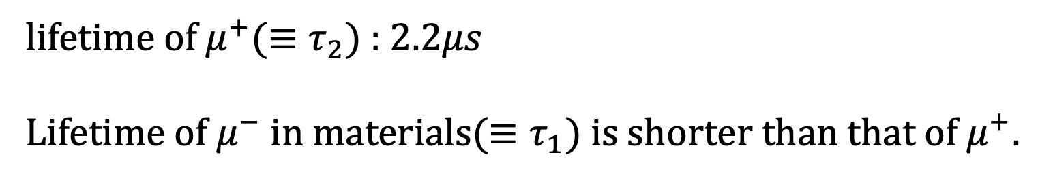
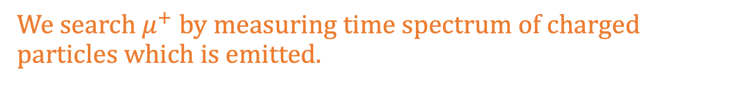



Experimental method
We search $μ^{+}$ by measuring time spectrum of charged particles which is emitted.
lifetime of $μ^{+}(≡τ_{2})$ : $2.2μs$
Lifetime of $μ^{−}$ in materials($≡τ_{1}$) is shorter than that of $μ^{+}.$
logN
$$N_{μ^{−}}e^{−\frac{t}{τ_{1}}}$$
We can separate signals derived from $μ^{−}$ and $μ^{+}$.
$$N_{μ^{+}}e^{−\frac{t}{τ_{2}}}$$
t

Slide 11
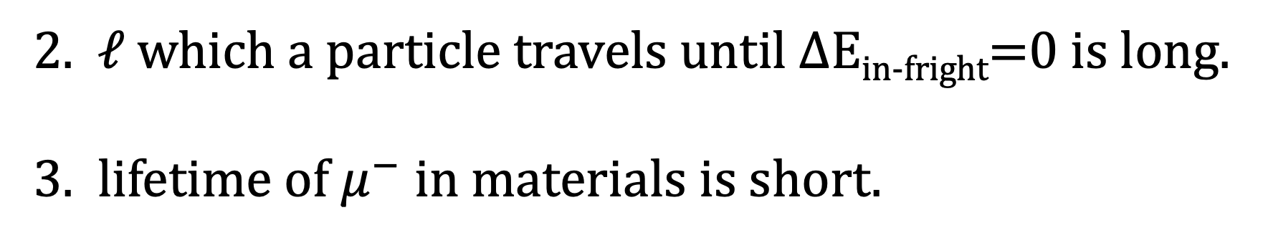


Choice of target
Requirement of ideal target
Cross section is large.
Possibility dP that reaction will happen while it passes through dx
$$dP=Nσdx$$
$σ :$ cross section
2. $ℓ$which a particle travels until $Δ$E_{in-fright}=0 is long.
3. lifetime of $μ^{−}$ in materials is short.

Slide 12
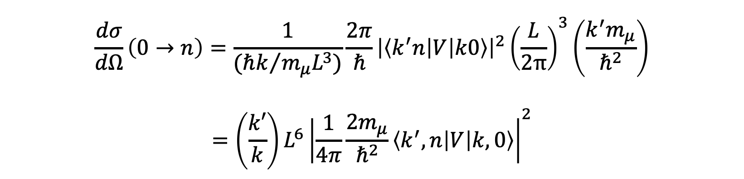
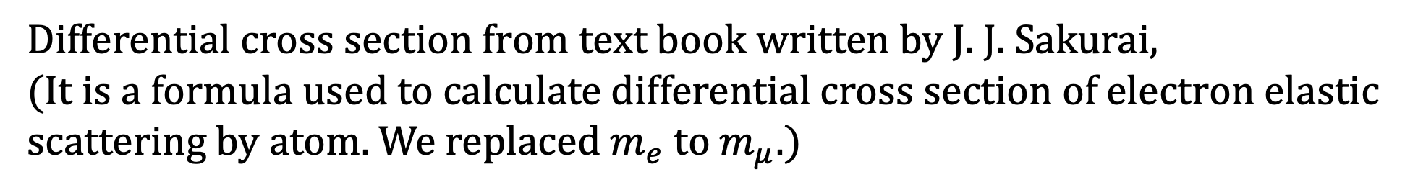
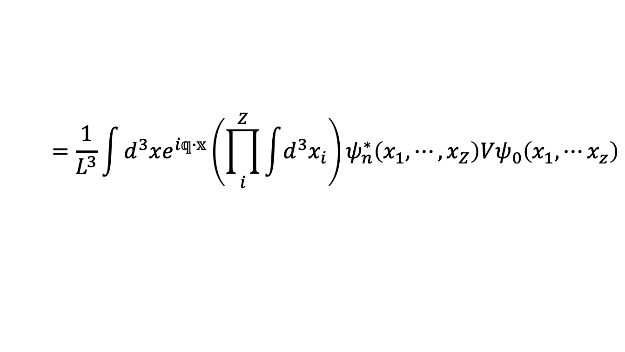
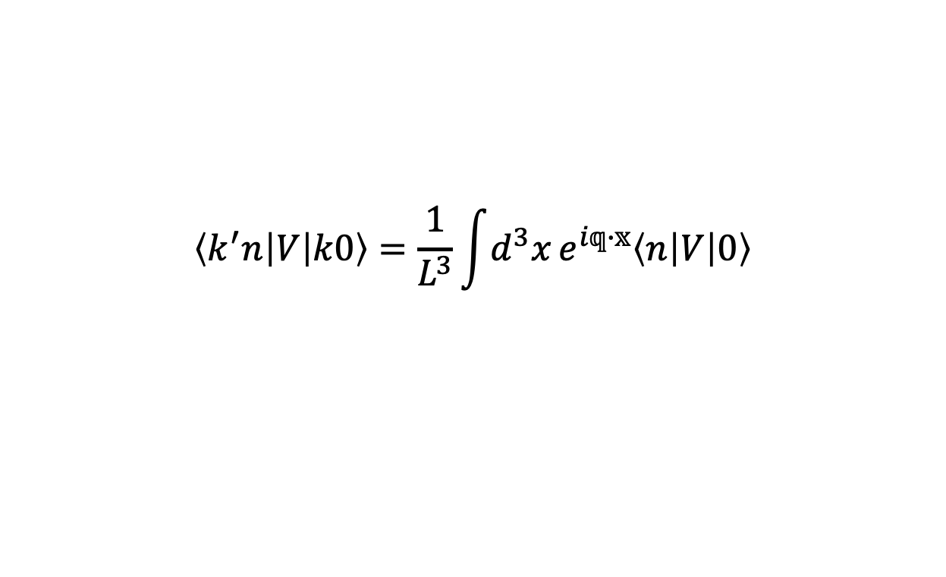
Cross section
Differential cross section from text book written by J. J. Sakurai,
(It is a formula used to calculate differential cross section of electron elastic scattering by atom. We replaced $m_{e}$ to $m_{μ}$.)
$$\frac{dσ}{dΩ}\left(0→n\right)=\frac{1}{({ℏk}/{m_{μ}L^{3})}}\frac{2π}{ℏ}{\left|\left\langle k^{′}n | V | k0\right\rangle \right|}^{2}{\left(\frac{L}{2π}\right)}^{3}\left(\frac{k^{′}m_{μ}}{ℏ^{2}}\right)$$
$$=\left(\frac{k′}{k}\right)L^{6}{\left|\frac{1}{4π}\frac{2m_{μ}}{ℏ^{2}}\left\langle k^{′},n | V | k,0\right\rangle \right|}^{2}$$
V : potential , k : wave number of incident particle , k‘ : wave number of scattering particle
$$\left\langle k^{′}n | V | k0\right\rangle =\frac{1}{L^{3}}\int{d^{3}x}e^{i𝕢∙𝕩}\left\langle n | V | 0\right\rangle$$
$$=\frac{1}{L^{3}}\int{d^{3}xe^{i𝕢∙𝕩}\left(\prod_{i}^{Z}{\int{d^{3}x_{i}}}\right)}ψ_{n}^{∗}\left(x_{1},⋯,x_{Z}\right)Vψ_{0}\left(x_{1},⋯x_{z}\right)$$
Notes:
最適な標的とはどのようなものか イラストも
検出方法も軽く説明する。
そのうちのcross section
教科書電子の弾性散乱の式を利用 電子をミューオンに変える 電子の原子による散乱の指揮を応用
入射粒子 散乱粒子の運動量 断面積を求める理由 FoMを先に述べる

Slide 13
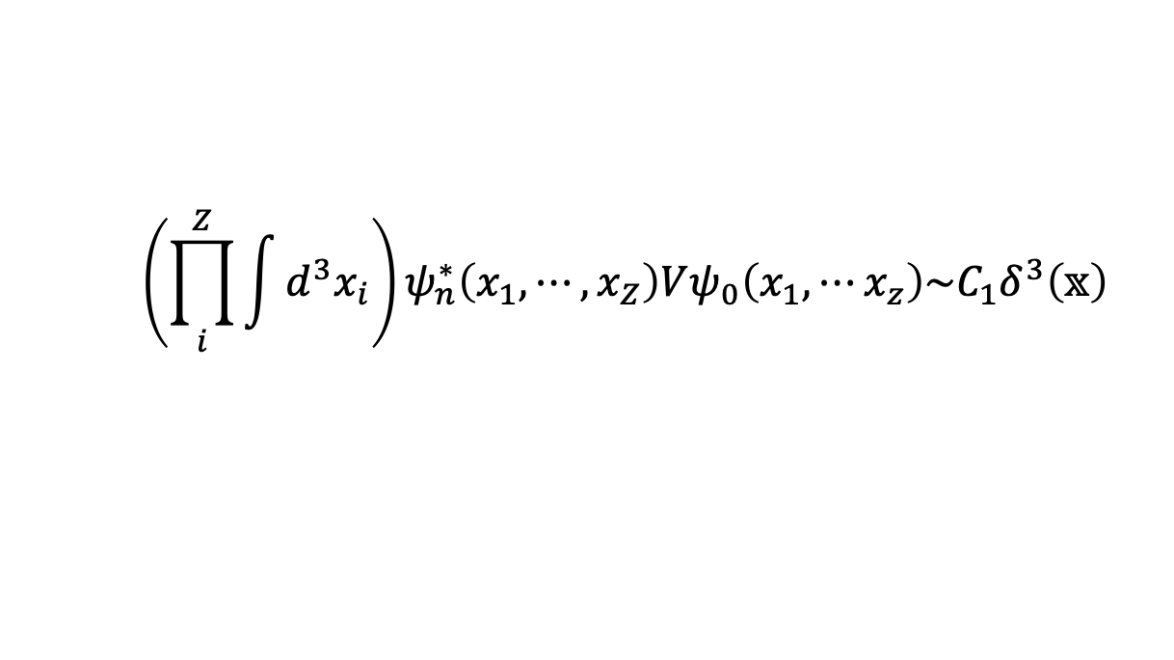
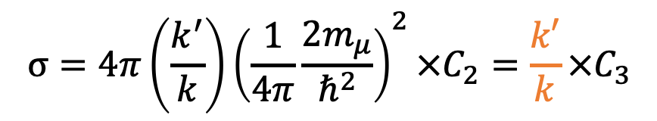
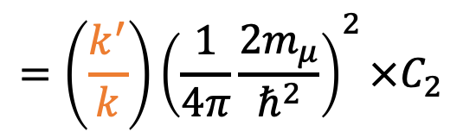
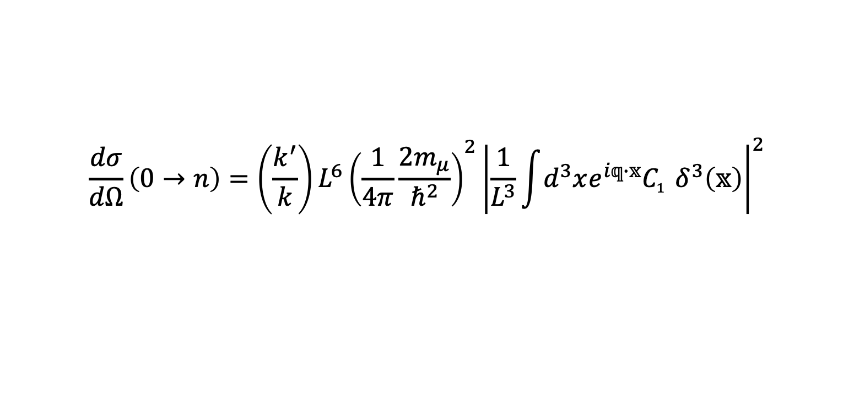
We assume that the reaction happen just close atomic nucleus,
We ignore a size of nucleus ,
$${\left(\prod_{i}^{Z}{\int{d^{3}x_{i}}}\right)ψ}_{n}^{∗}\left(x_{1},⋯,x_{Z}\right)Vψ_{0}\left(x_{1},⋯x_{z}\right)\sim C_{1}δ^{3}\left(𝕩\right)$$
Differential cross section
$$\frac{dσ}{dΩ}\left(0→n\right)=\left(\frac{k^{′}}{k}\right)L^{6}{\left(\frac{1}{4π}\frac{2m_{μ}}{ℏ^{2}}\right)}^{2}{\left|\frac{1}{L^{3}}\int{d^{3}xe^{i𝕢∙𝕩}{C_{1}^{}δ}^{3}\left(𝕩\right)}\right|}^{2}$$
$$=\left(\frac{k^{′}}{k}\right){\left(\frac{1}{4π}\frac{2m_{μ}}{ℏ^{2}}\right)}^{2}×C_{2}$$
Integrate both sides with respect to solid angle
$$σ=4π\left(\frac{k^{′}}{k}\right){\left(\frac{1}{4π}\frac{2m_{μ}}{ℏ^{2}}\right)}^{2}×C_{2}=\frac{k′}{k}×C_{3}$$
Notes:
有限な大きさの原子 今回は原子核の大きさを0（点）として
Propotional K’/K 強調
怪しい部分があることを述べる

Slide 14
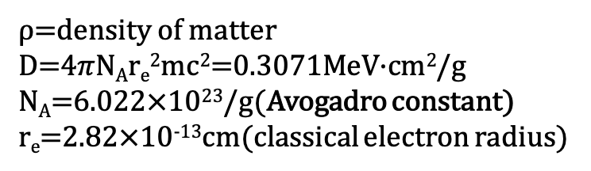
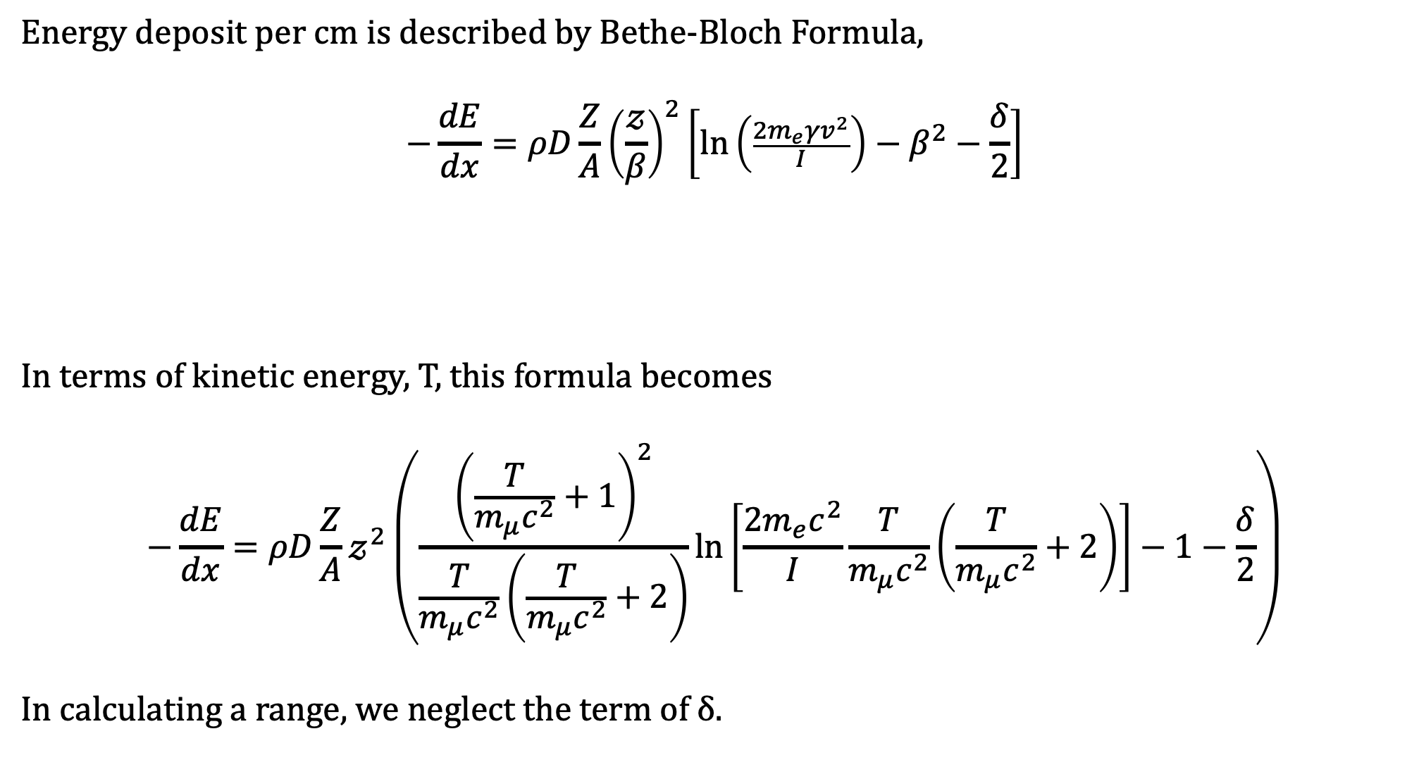

How to get a range
Energy deposit per cm is described by Bethe-Bloch Formula,
$$−\frac{dE}{dx}=ρD\frac{Z}{A}{\left(\frac{𝓏}{β}\right)}^{2}\left[\ln\left(\frac{2m_{e}γv^{2}}{I}\right)−β^{2}−\frac{δ}{2}\right]$$
In terms of kinetic energy, T, this formula becomes
$$−\frac{dE}{dx}=ρD\frac{Z}{A}𝓏^{2}\left(\frac{{\left(\frac{T}{m_{μ}c^{2}}+1\right)}^{2}}{\frac{T}{{m_{μ}c}^{2}}\left(\frac{T}{{m_{μ}c}^{2}}+2\right)}\ln\left[\frac{2{m_{e}c}^{2}}{I}\frac{T}{{m_{μ}c}^{2}}\left(\frac{T}{{m_{μ}c}^{2}}+2\right)\right]−1−\frac{δ}{2}\right)$$
In calculating a range, we neglect the term of δ.
ρ=density of matter
D=4$π$N_{A}r_{e}²mc²=0.3071MeV·cm²/g
N_{A}=6.022$×$10²³/g(Avogadro constant)
r_{e}=2.82$×$10⁻¹³cm(classical electron radius)
Z,A=atomic number and atomic mass of matter
$𝓏$=charge of a incoming particle
I$≅$16Z^{0.9}eV(average of ionization potential)
δ=quantity of density effect

Slide 15
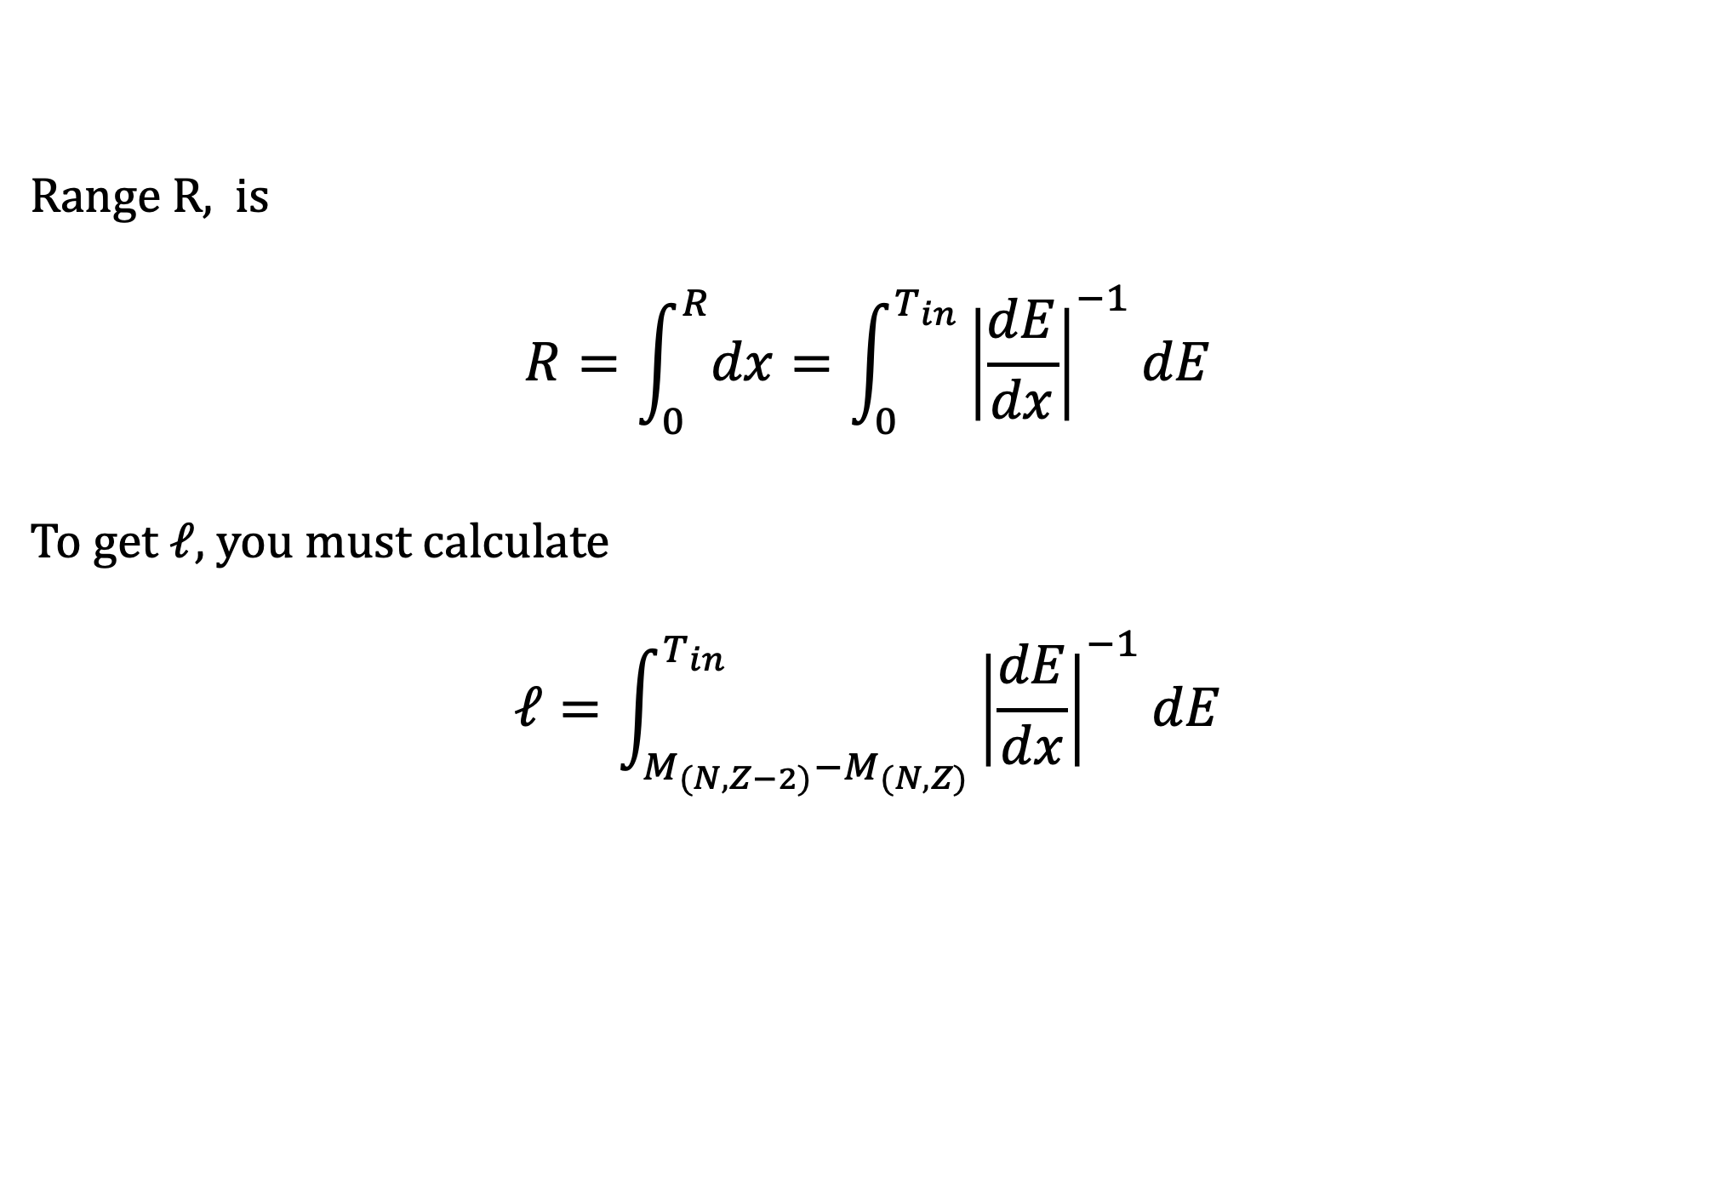
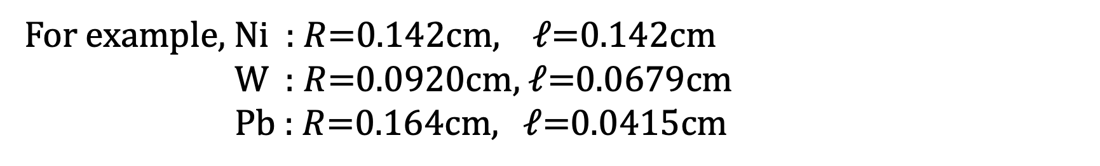
Range R, is
$$R=\int_{0}^{R}{dx}=\int_{0}^{T_{in}}{{\left|\frac{dE}{dx}\right|}^{−1}dE}$$
To get $ℓ$, you must calculate
$$ℓ=\int_{M_{(N,Z−2)}−M_{(N,Z)}}^{T_{in}}{{\left|\frac{dE}{dx}\right|}^{−1}dE}$$
For example, Ni : $R$=0.142cm, $ℓ$=0.142cm
W : $R$=0.0920cm, $ℓ$=0.0679cm
Pb : $R$=0.164cm, $ℓ$=0.0415cm
Notes:
有効数字
プロットもあり？

Slide 16

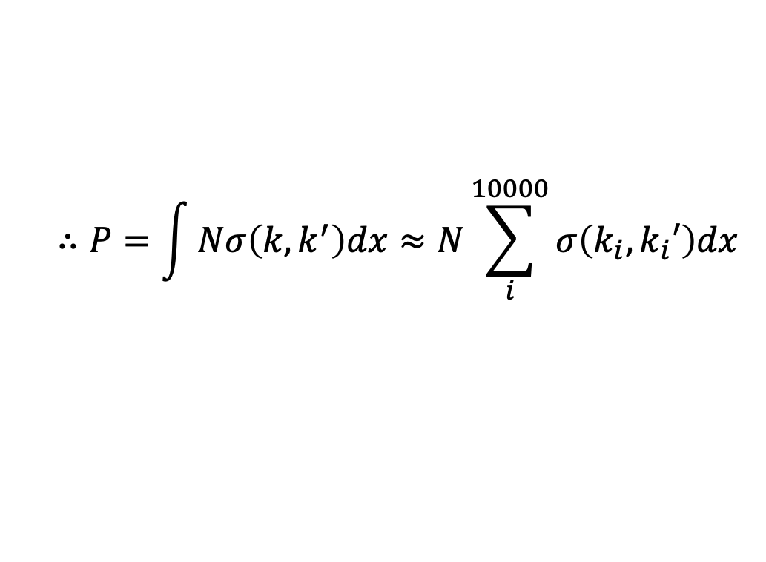
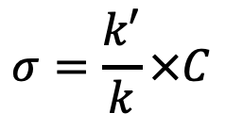







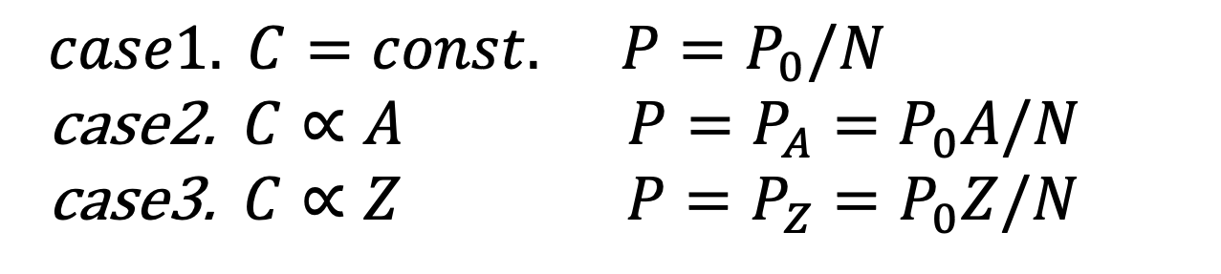
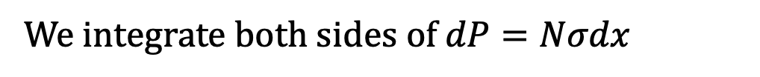
Figure of Merit
We integrate both sides of $dP=Nσdx$
$$∴P=\int{Nσ\left(k,k^{′}\right)dx≈N\sum_{i}^{10000}{σ\left(k_{i}, k_{i}′\right)dx}}$$
1
2
10000
Considering energy conservation, we can calculate k’.
$$E_{in–flight}$$
$$σ_{1}$$
$$σ_{2}$$
$$σ_{10000}$$
$$σ=\frac{k′}{k}×C$$
$$⋯$$
cross section
$$dx$$
$$dx$$
$$E_{in–flight}=0$$
We considered 3 cases that matrix element depends on atomic number or mass number.
$case1. C=const. P=P_{0}/N$ case2. $C∝A P=P_{A}=P_{0}A/N$ case3. $C∝Z P=P_{Z}=P_{0}Z/N$
Notes:
数値積分したことを述べる integrated
3case がわかりやすいことを書く
EiとEfがわかるので、運動量はわかる。 式はいらない。

Slide 17
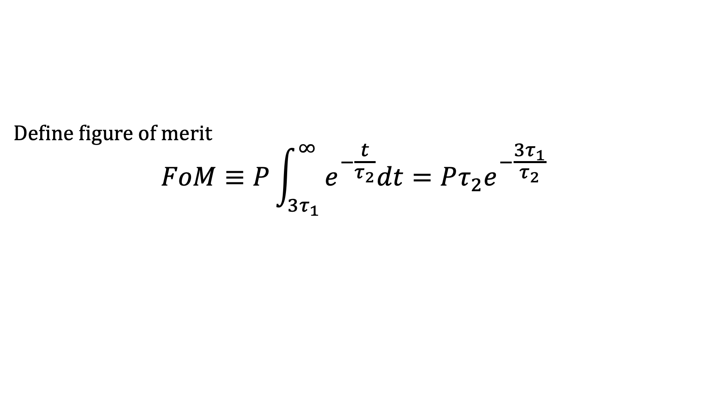
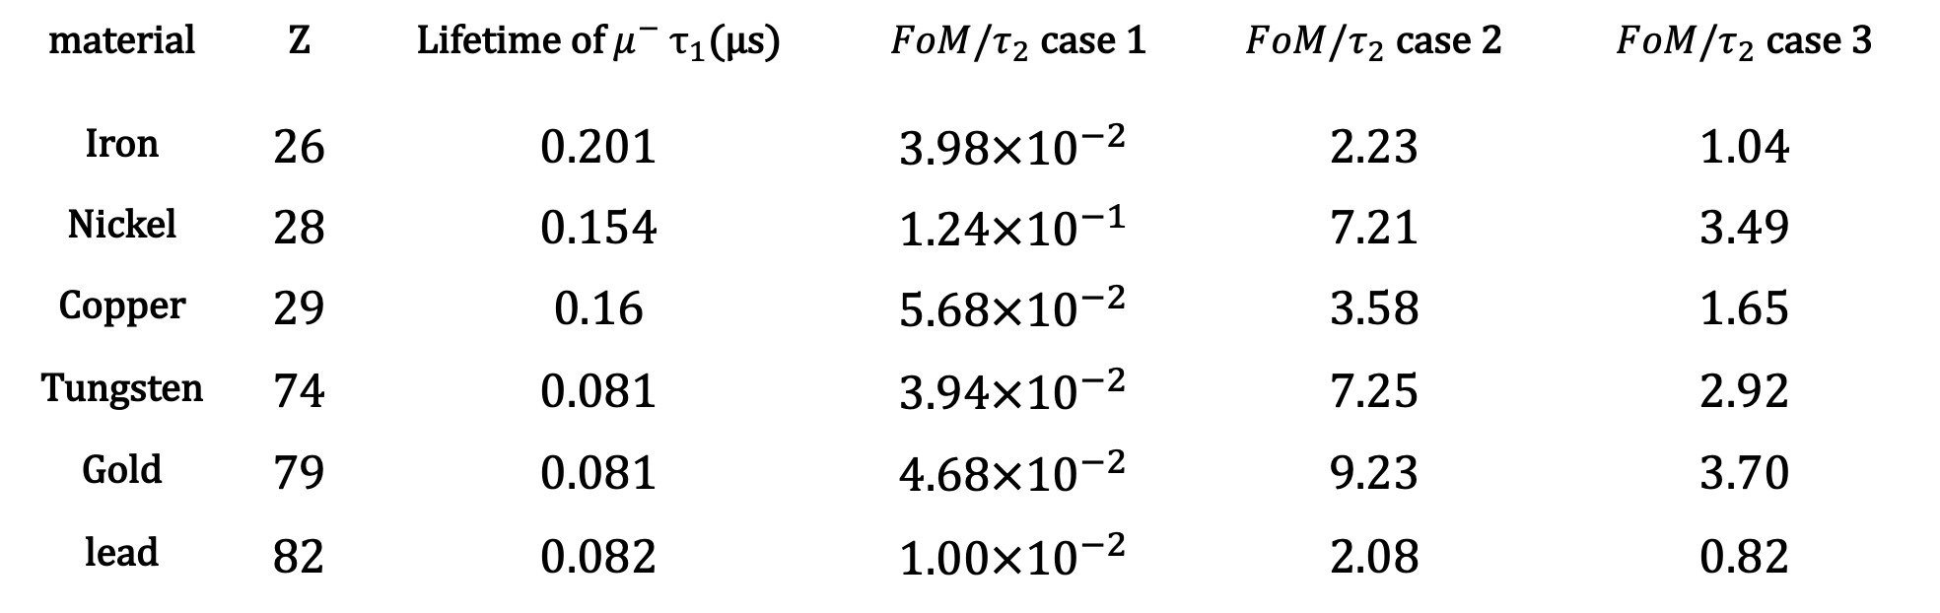
Define figure of merit
$$FoM≡P\int_{3τ_{1}}^{∞}{e^{−\frac{t}{τ_{2}}}dt}=Pτ_{2}e^{−\frac{{3τ}_{1}}{τ_{2}}}$$
Calculation of Figure of Merit
material | Z | Lifetime of $μ^{−}$ $τ_{1}$(μs) | $FoM/τ_{2}$ case 1 | $FoM/τ_{2}$ case 2 | $FoM/τ_{2}$ case 3
Iron | 26 | 0.201 | $$3.98×{10}^{−2}$$ | 2.23 | 1.04
Nickel | 28 | 0.154 | $$1.24×{10}^{−1}$$ | 7.21 | 3.49
Copper | 29 | 0.16 | $$5.68×{10}^{−2}$$ | 3.58 | 1.65
Tungsten | 74 | 0.081 | $$3.94×{10}^{−2}$$ | 7.25 | 2.92
Gold | 79 | 0.081 | $$4.68×{10}^{−2}$$ | 9.23 | 3.70
lead | 82 | 0.082 | $$1.00×{10}^{−2}$$ | 2.08 | 0.82
Candidacy …Tungsten , Lead , Gold , Nickel
Notes:
P とバックグラウンドを考えて３τ1以降を考える
Τ1
グラフでかく
各caseを検討した旨を述べる

Slide 18
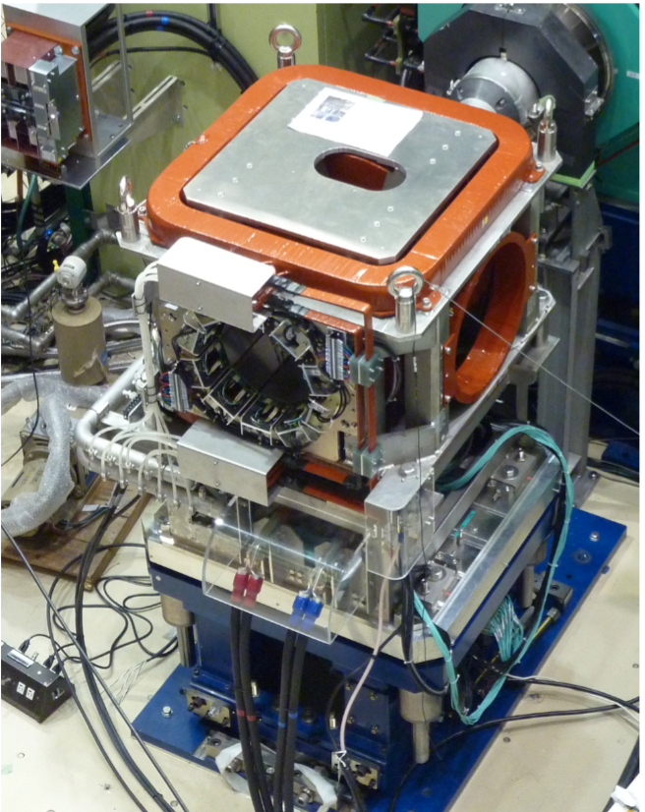
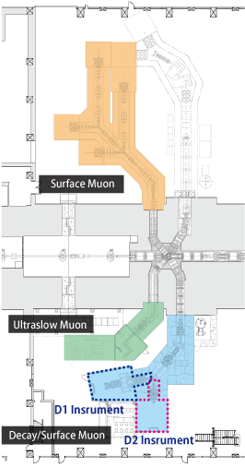



Equipment, place
Cosmic ray veto counter
Kalliope detector
Beam halo veto counter
target
$μ^{−}$beam
J-PARC , D1 beamline , μSR spectrometer
Notes:
μ+を測定するコンセプトを述べる
時間スペクトルを測れば良いことを述べる
JPARCの航空写真
Counterの説明 写真と対比

Slide 19



What is Kalliope?
Kalliope is a positron/electron detector system.
It is composed of three blocks:
·the detector block
·the analogue board
·the digital board.
The detector block includes
·a plastic scintillator cube(1cm$×$1cm$×$1.2cm)
·wave-length shifting (WLS) fiber
· p-APD.
Two cubic scintillators aligned in series take coincidence of signal.
Notes:
すでに現場にあるため、ターゲットを持っていくだけでデータを取れる。
あとは解析

Slide 20


Expected spectrum
·How many electrons does a target emit?
·How long is muon lifetime in target?
muon capture(µ⁻+p→n + $ν$_{µ})
(MC)
stopped muon in a target
decay in orbit(µ⁻→e⁻+ $ν$_{µ}+$\overline{ν_{e}}$)
(DIO)
I want to know each probability!
Notes:
測定方法から、電子、陽電子の出てくる時定数、頻度を知るため
DIOのみ荷電粒子が出てくるので測定可能

Slide 21

Expected spectrum
We set Γ_{tot} , Γ_{cap} and Γ_{decay} as the width of total decay, absorbing in nucleus and free muon’s decay respectively.
Γ_{tot}=Γ_{cap}+Γ_{decay}
for lead, Γ_{cap}=11.7$×$10⁶/s, Γ_{decay}=0.50$×$10⁶/s
→ Γ_{tot}=12.20$×$10⁶/s
So, probability of DIO → Γ_{decay}/Γ_{tot}≈4.1%
muon lifetime → 1/Γ_{tot}≈0.082µs

Slide 22
Expected spectrum
We just determined the value in order to observe µ⁻µ⁺ conversion for 5 hours.
There are no physical meanings.
Condition
1, beam intensity→10⁷/s
2, solid angle→23%
3, beam time→5hours
4, target→lead
5, probability of µ⁻µ⁺ convertion→10⁻⁹
Under this condition, we simulated an expected spectrum without background.
Notes:
Probabilityに関して
5 Assumption
線を太くする 等

Slide 23
Expected spectrum
blue : DIO
red : e⁺ event
If we will select data after 3µs(the reason is described later), single event sensitivity becomes about 1$×$10⁻¹⁰ .

Slide 24
Background
Cosmic rays
Impurity
Others

Slide 25
background(cosmic rays)
This is so simple idea.
Condition
1, Cosmic rays penetrate a detector vertically.
2, rate→1 count/min/cm²
3, cross-section which cosmic rays penetrate→216cm²
4, pulse span→40ms, data time→10µs, observation time→5hours
pulse
cosmic ray
10µs
time
40ms
Under this condition, we will get about 16 events from cosmic rays.
Notes:
Back ground の list を先に述べる
イラスト
Assumption とconditionを分ける

Slide 26
background(cosmic rays)
But, two cubic scintillators aligned in series take coincidence.
cosmic ray
e⁻ from DIO
scintillator
coincidence
target
So, this value may be wrong.
If we can, we must reconsider taking into account of angular distribution of cosmic rays.
Anyway, we will eliminate events of cosmic rays.
Notes:
Targetも書いた方が良い
Vetoできるものとそうでないものがある

Slide 27



BG by impurity element
ex. Case of Pb target
impurities: Fe , Cu, Bi, .....
Relatively long-life time
$$N$$
Pb: life time =0.082µs
Impurity(long life time element)
Obstruct
2.2µs signal
µ+:2.2µs
$$(µs)$$

Slide 28




Fermi- Teller Z law
Z
$$N_{Z}$$
Target
Z’
$$N_{Z′}$$
µ- : $N_{µ}$
Interaction ratio = $N_{Z}$Z : $N_{Z′}$Z’

Slide 29




Calculation of BG after time t
$BG\left(t\right)=\frac{S\left(∞−t\right)}{S\left(∞−0\right)}N$ N: the number of µ- for each impurity element
$S\left(∞−t\right)=\int_{t}^{∞}{dt′Ne^{−t′/τ}}$ τ: mean life for each impurity element
Example
(Pb and Fe)
N
$$N_{Pb}\exp\left(−\frac{t}{τ_{Pb}}\right)$$
Black : signal by Pb
Pink : signal by Fe
$$N_{Fe}exp⁡(−\frac{t}{τ_{Fe}})$$
t(µs)

Slide 30

Results of calculation (Pb:ヨシザワLD JIS H 4301)
After the time2.74µs, we can eliminate BG by impurities(the number of BG<<1).

Slide 31

Calculation for Ni (Ni : E-Metals KST B 1018)

Slide 32
Other backgrounds(under calculation)
Radioactive decay
muon are captured by atom → unstable
Atomic nucleus decay
Parent
isotope
Daughter isotope
e-
p
atomic nucleus
broken nucleus
µ-
n
Collide µ- in much momentum

Slide 33

Preparation
Veto counter
for eliminating cosmic ray, muon
which don’t interact with target
and are detected by counter.
Check of PMT operation
Cosmic ray veto counter
counter
???
Beam veto counter
→
target

Slide 34

What are PMTs?
PMTs are photodetectors which convert a light signal into an electrical signal.
A photocathode emits a electron(a photoelectron) when it absorbs a photon. This electron is accelerated and reaches the first dynode and ejects several electrons. Each electron of them ejects several electrons at the next dynode in same way. After repeating this process many times, you can get about ${10}^{6}$ electrons.

Slide 35
Beam time schedule
Beam: J-PARC MLF D1 area
Schedule
1/23 afternoon : preparation
1/24 9:00~21:00: beam time (12hours)
allotment : 5h for Pb,5h for Ni
(we want to compare the result of those)

Slide 36

Summary
$μ^{−}+\left(N,Z\right)→μ^{+}+\left(N,Z−2\right)$
Stopped : radionuclides → in-flight
( many available materials)
Time spectrum → double exponential signal
→ get signal of 2.2µs life time
But many BG should be exist
(eliminate by counter , under calculation)
Can be experiment of confirming that neutrino are Majorana!

Slide 37
Thank you for listening!
Sorry for poor English. . .

