Slide 1
Study of QED and BSM with Production of True Muonium -Similarity and Dissimilarity- Takahisa Itahashi Graduate School of Science, Osaka University
Contents
Introduction
Similarity and dissimilarity
Examples and proposal
POP experiment
Summary and perspectives

Slide 2
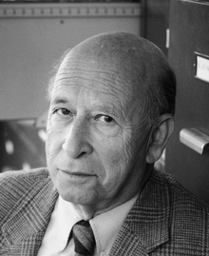
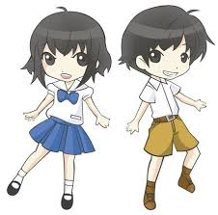
to look beyond the established physics : such as beyond QED or QCD
Analogy is perhaps the physicist’s most powerful -conceptual tool for understanding new phenomena or opening new areas of investigation.
(V. L. Telegdi)[Te62] appeared in the Ch. 13, Quarkonia of PARTICLES and NUCLEI by Povh, Rith, Scholz , Zetsche
-Similarity and Dissimilarity-
Atomic Physics
Nuclear or Sub-atomic Physics
Lepton
Quarkonium
His arguments has been alive now

Slide 3
Simple and pure(QED)
there are several candidates to be studied
(e+ e-)
(μ+ e-)
(μ− e+)
(μ+ μ−)
(τ+ τ−)
(τ+ μ−)
(τ+ e-)
(p+e-)
(p+μ-)
pure and compact (106000 fm and 512 fm )
Tm / Dm
pure leptonic
exotic atom

Slide 4
GeV/c
³S₁
²P_{3/2}
²P_{3/2}
³S₁
³P₂
¹P₁
³P₂
²P_{1/2}
³P₂
³P₁
¹S₀
¹P₁
¹P₁
³P₀
²S_{1/2}
³P₁
³P₁
n = 2
¹S₀
²P_{1/2}
²S_{1/2}
³P₀
³P₀
¹S₀
¹S₀
Hydrogen
μH
e⁺-e⁻
μ⁺-μ⁻
c⁺-c⁻
b⁺ - b⁻
-Similarity and Dissimilarity-

Slide 5
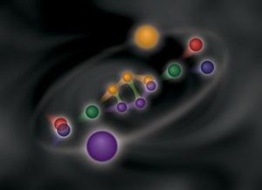
Precision studies of energy levels Precision studies of fine structure & hyper fine structure and Precision studies of Lamb shift
H.E. version
e+ e-
μ⁻
virtual photon
Is this possible or not ??
virtual photon
e+ e-
μ+
(μ+ μ−)
proposed
Decay
Excitation
could be studied

Slide 6
True muonium level diagram
P.R.L.１０２，２１３４０１（２００９）
E, ΔE, Br, τ
Spectroscopic calculation can predict the energy levels , lifetimes and hyperfine structures
production ???
n=∞(E=0eV)
3 ³S₁
theory
n=3(E=-156eV)
3 ¹S₀
γ(1.53 ns)
e⁺e⁻ (48.8 ps)
γγ(16.3 ps)
2 ³S₁
proposed
n=2(E=-352eV)
2 P
2 ¹S₀
e⁺e⁻ (14.5 ps)
γγ(4.81 ps)
1 ³S₁
n=1(E=-1407eV)
γ(15.4 ps)
1 ¹S₀
e⁺e⁻ (1.81 ps)
γγ(0.602 ps)

Slide 7
In the past and up to the latest, many production channels have been proposed and discussed such as;
pion proton collision: π p→(μ⁺μ⁻) n,
photon or electron on nuclei: γ Z→(μ⁺ μ⁻) Z, e Z → e(μ⁺ μ⁻) Z,
direct collision : μ⁺ μ⁻→(μ⁺ μ⁻) ,
collision : e⁺ e⁻ → (μ⁺ μ⁻), e⁺ e⁻→ (μ⁺ μ⁻) γ, KEKB-KOTO exp.
decay of neutral meson η⁰ → (μ⁺ μ⁻) γ,
Z₁ Z₂ → Z₁ Z₂ (μ⁺μ⁻)
q⁺q⁻→(μ⁺μ⁻) γ in a quark plasma

Slide 8
X-rays from (μ+μ−) EM transitions such as 2P-1S
2P lifetime
DE (2S->2P)
r = 100 μm

Slide 10
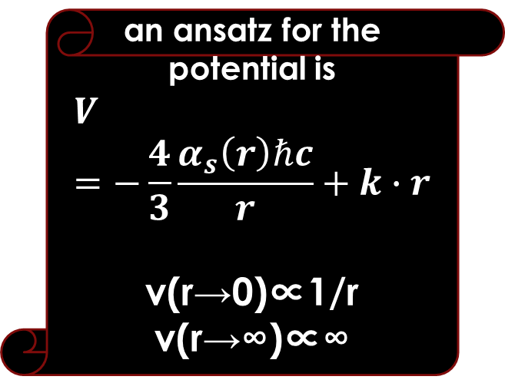
an ansatz for the potential is
$$V=−\frac{4}{3}\frac{α_{s}\left(r\right)ℏc}{r}+k∙r$$
v(r→0)∝1/r
v(r→∞)∝∞
2³S₁
2¹S₀
2³P₂
2¹P₁
E1 transition
2³P₁
M1 transition
2³P₀
1¹S₀
c⁺-c⁻
1¹S₀

Slide 11
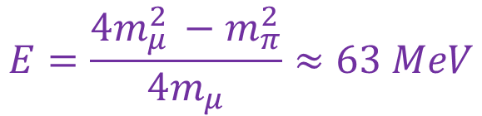
1) New decay mode <– Ortho-Positronium
2) Decay of the dimuonium into a photon and a neutral pion
Decay rate of Dm => π⁰γ
mentioned by A.Czarnecki. & S.G.Karshenboim.
The decay can be used to establish the presence of Dm/Tm
$$E=\frac{4m_{μ }^{2}−m_{π}^{2}}{4m_{μ}}≈63 MeV$$
π⁻
π₀
w⁻
μ⁻
μ⁻
γ
D_{m}
D_{m}
μ⁺
γ
μ⁺
μ⁺
w⁺
ν_{e}

Slide 12

Virtual annihilation into π₀γ possible only for ortho-Dm appeared in PRD 96 011302 ８（２０１７）
μ⁻
π₀
μ⁻
γ
γ
μ⁺
μ⁺
γ
$$E=\frac{4m_{μ }^{2}−m_{π}^{2}}{4m_{μ}}≈63 MeV$$

Slide 13
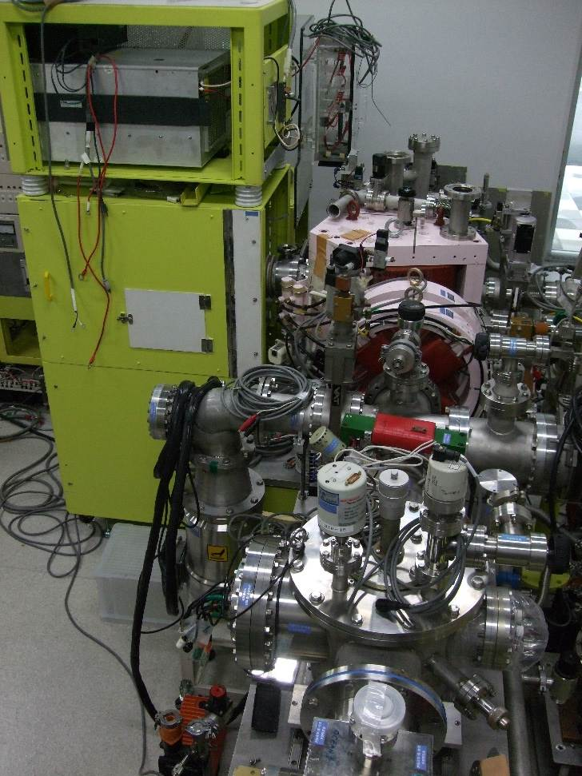
Several ideas have been proposed so far in our Faculty – LEMAM as a collider or merger instrumentation at low-energy scheme
POP experiments with proton
Merging – proton and HI
Muonic atom in flight
Frictional cooling-- moderator
Ionized matter—plasma
Doppler shift
Large n-value– Auger electron
High energy photon detection

Slide 14
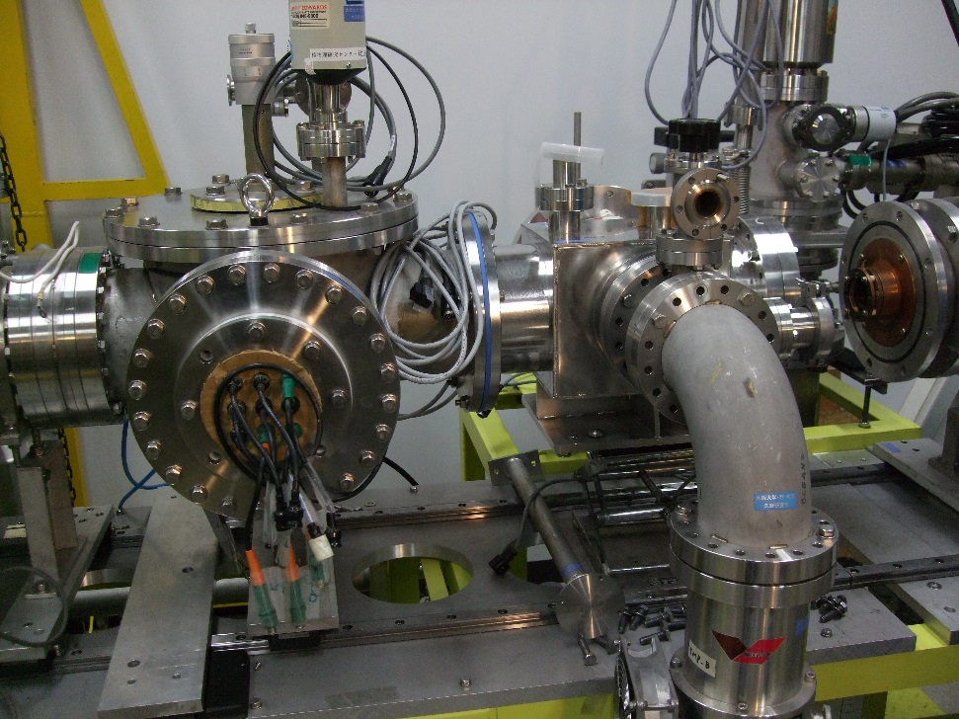
frictional cooling devices
collimators and detectors
In the Faculty

Slide 15
3
moderator
thin foil
RF
negative pot.
ext. electrode
anal. mag.
detector
7
p⁺μ⁻
μ⁺μ⁻
He⁺⁺
2
He⁺μ⁻
He⁺⁺
1
5
1
e-
^{μ−}
^{μ−}
^{μ−}
^{μ−}
He⁺μ⁻
μ+ beam
He⁺⁺
e-
6
μ- beam
He⁺⁺
e-
e-
^{μ+}
^{p+}
4
MIRROR or CUSP M.F.
proton beam

Slide 16
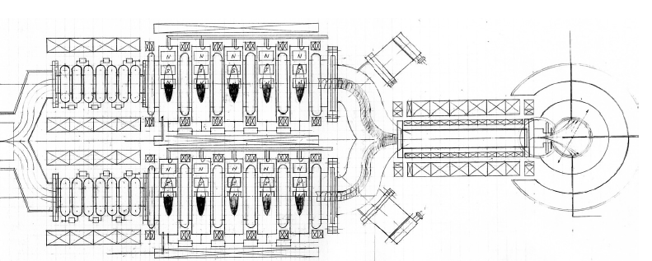

Potential U
low energy scheme
almost the same procedures applied for μ+ and μ-
Deceleration
Friction & Acceleration
Moderator
Vacuum Pump
Detectors
Damping Solenoid
μ+
μ-
< 1keV
Matching section
Solenoid
Vacuum Pump
Deceleration, cooling and acceleration
Resistive chain + Electron Cyclotron Resonance
preliminary

Slide 17
Summary
Analogy-similarity-dissimilarity
Atomic and subatomic physics
Simple and pure atom
Production of Tm, Dm
POP apparatus
LEMAM
Quests of several physics interests in TM
Traditional and new physics
(Fine structure, hyperfine structure, Lamb Shift)
Strategy of production for TM in LEMAM
Frictional cooling (VN)
POP facility and simulation study
FRESH device (VN)
Perspectives
科研費

