Slide 1
MuSIC (RCNP) analyze beam data and g4beamline simulation
2019/12/23 Year-end Presentation
Genta Hamano

Slide 2
Outline
・Motivation
・Mu SIC Beam line
・MuSIC Beam test (TOF )
・G4Beamline simulation
・Future

Slide 3
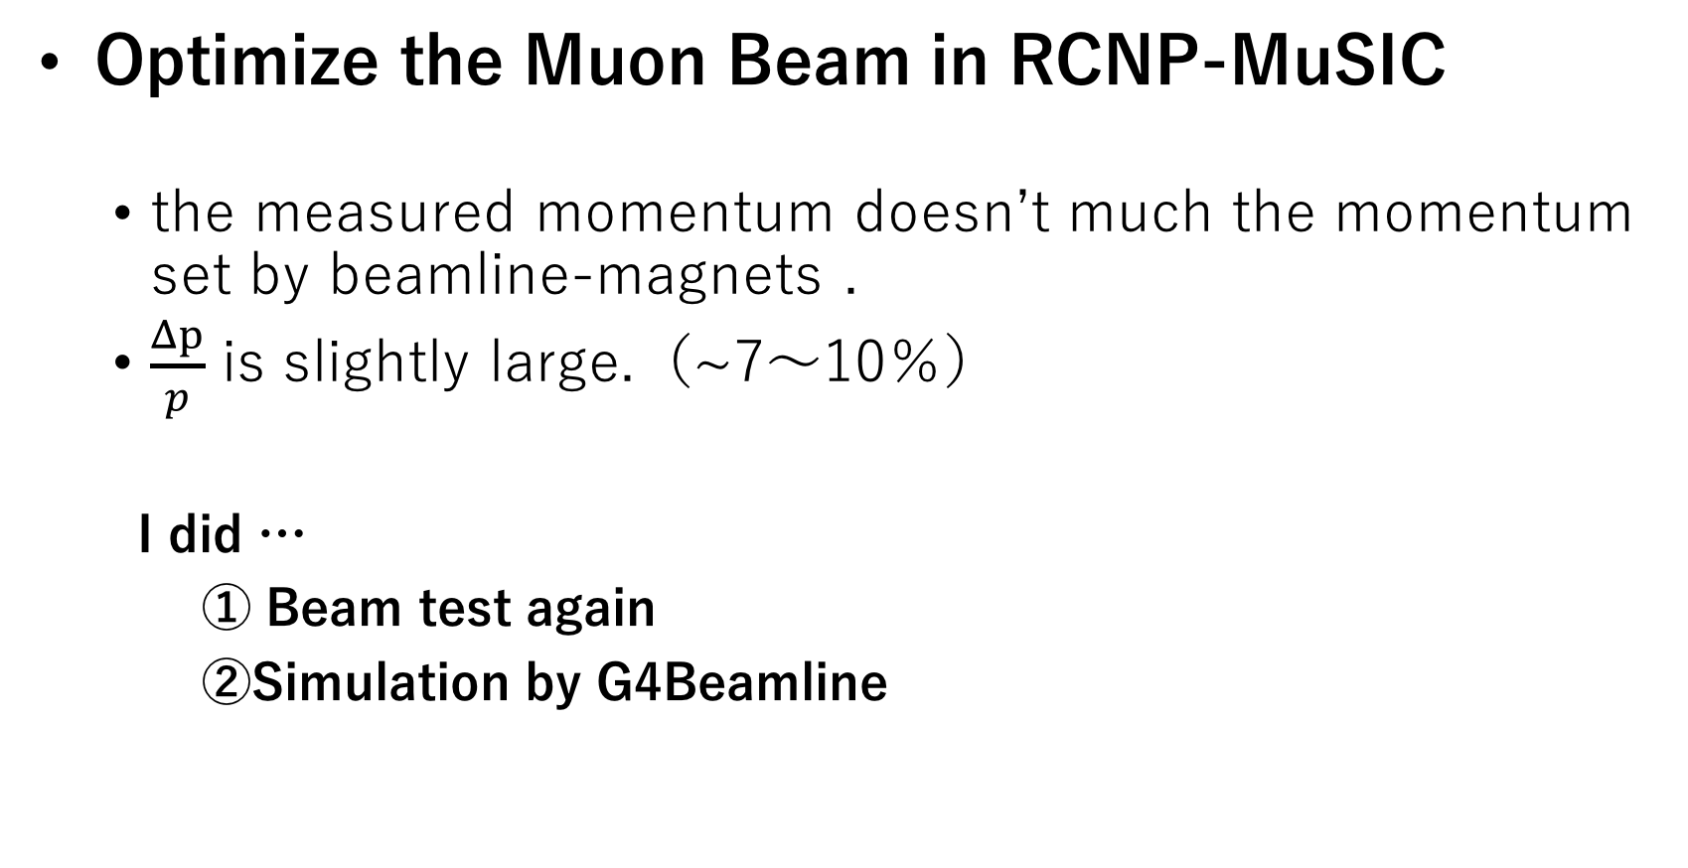
Motivation
Optimize the Muon Beam in RCNP-MuSIC
the measured momentum doesn’t much the momentum set by beamline-magnets .
$\frac{Δp}{p}$ is slightly large.（~7〜10％）
I did …
① Beam test again
②Simulation by G4Beamline

Slide 4
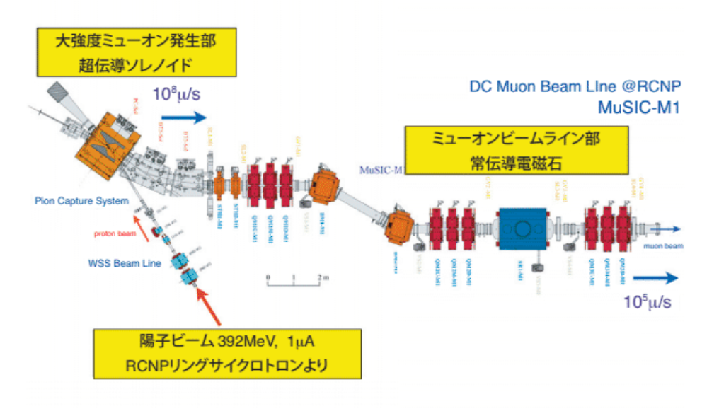
MuSIC beam line
・in Osaka University(RCNP)
・DC muon beam line
・Large Pion-Production-Target
in Capture-Solenoid
C(target)

Slide 5
Beam test (TOF)
September 2018 at RCNP
Plastic-scintillator(100×100×5 mm)
connected to PMT -H7195 set .
Obtain TDC-data and ADC-data of muons and positrons .
Set the Magnets for the each momentum .
(p = 40 , 50 , 60 , 70 MeV/c)
Get data of TOF(Time Of Flight).
10 mm
ビーム
10 mm

Slide 6
Raw data
electron
540ns
60MeV/c
proton
RFt
Muon
μ
RFt
e
・trigger signal is TOF1(left side signal of scintillator)
・RFt signal is regular intervals (par 540 ns)
→RFt signal shows the TOF (Time of flight )

Slide 7
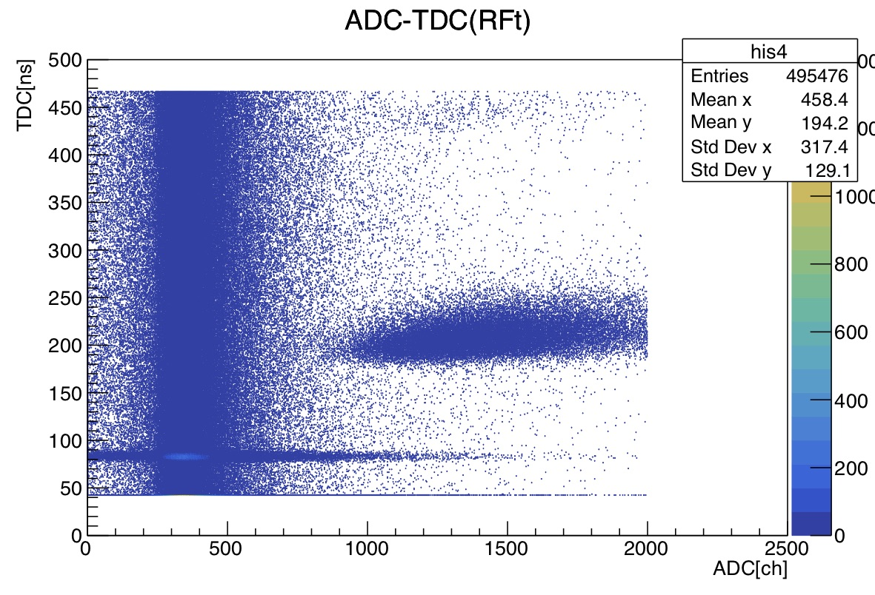
Back Ground
Identify μ and e by the flight-time.
Constant back ground !
Get only μ- events (inside of the square)
40MeV/c
e
μ
BG
μ
e
μ

Slide 8
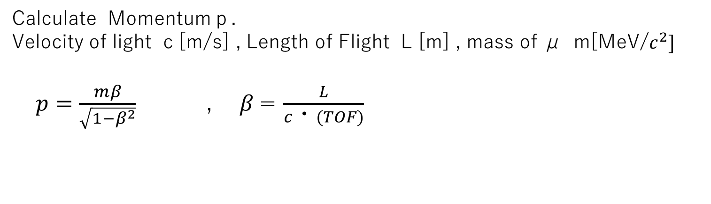
Calculate momentum of Muon
Calculate Momentumｐ.
Velocity of light c [m/s] , Length of Flight L [m] , mass of μ m[MeV/$c^{2}]$
$p=\frac{mβ}{\sqrt{1−β^{2}}}$ , $β$= $\frac{L}{c・(TOF)}$
Center-line Length
The Length from Production-target to plastic-scintillator .
23.003m
1.072m
μ e π
Production-target
Scintillator
Suppose the length of flight (L=24.075m )

Slide 9
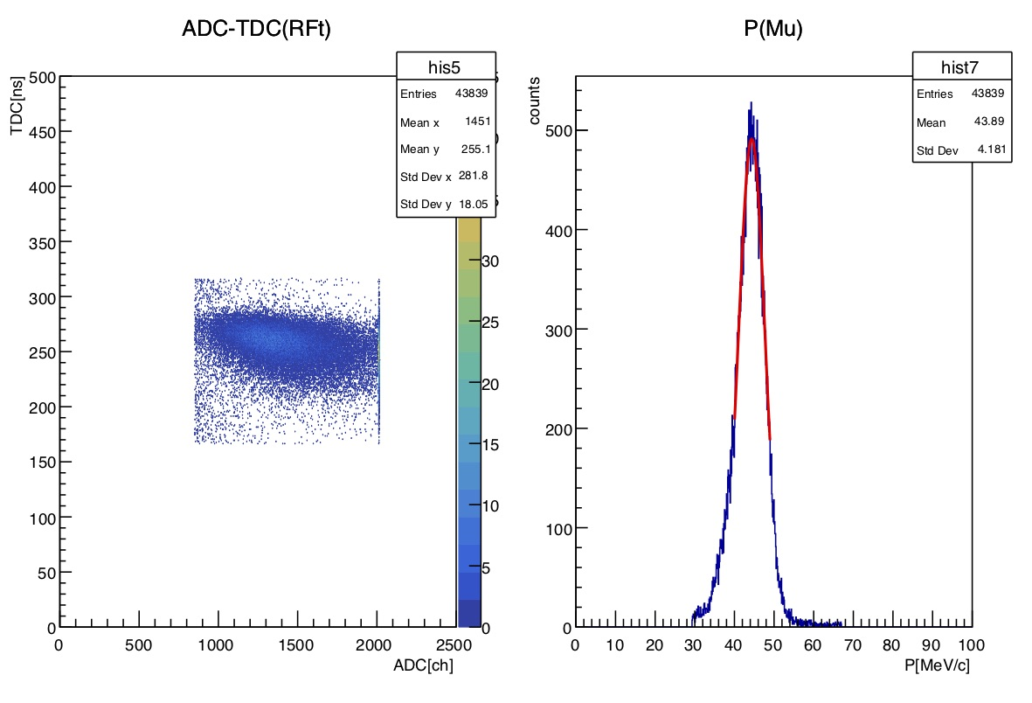
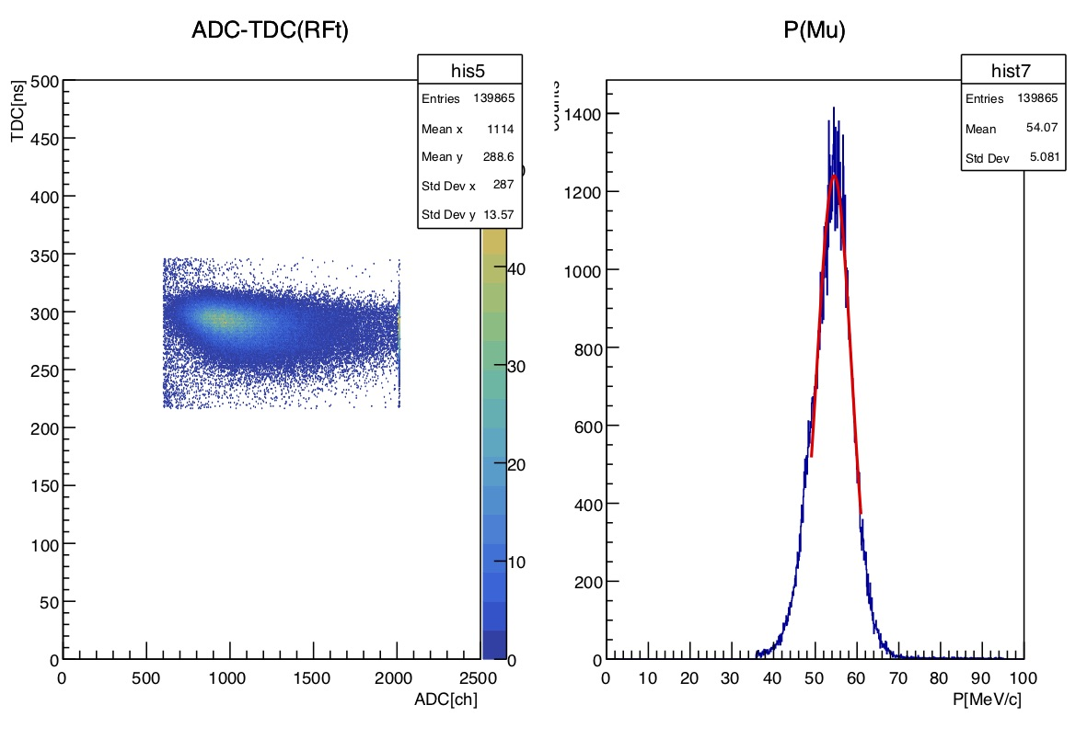
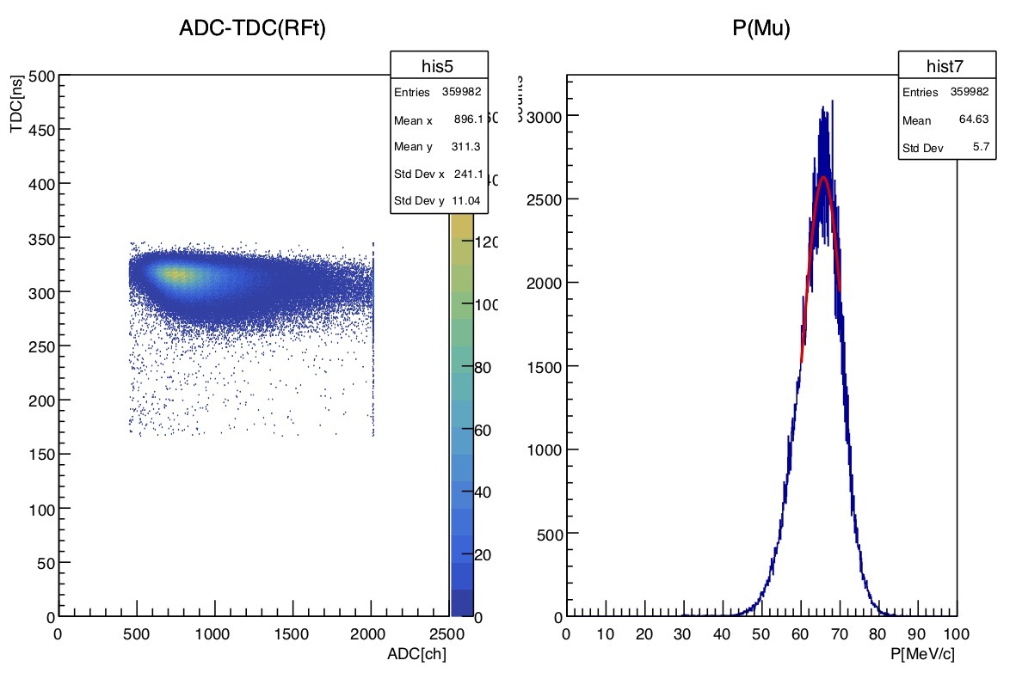
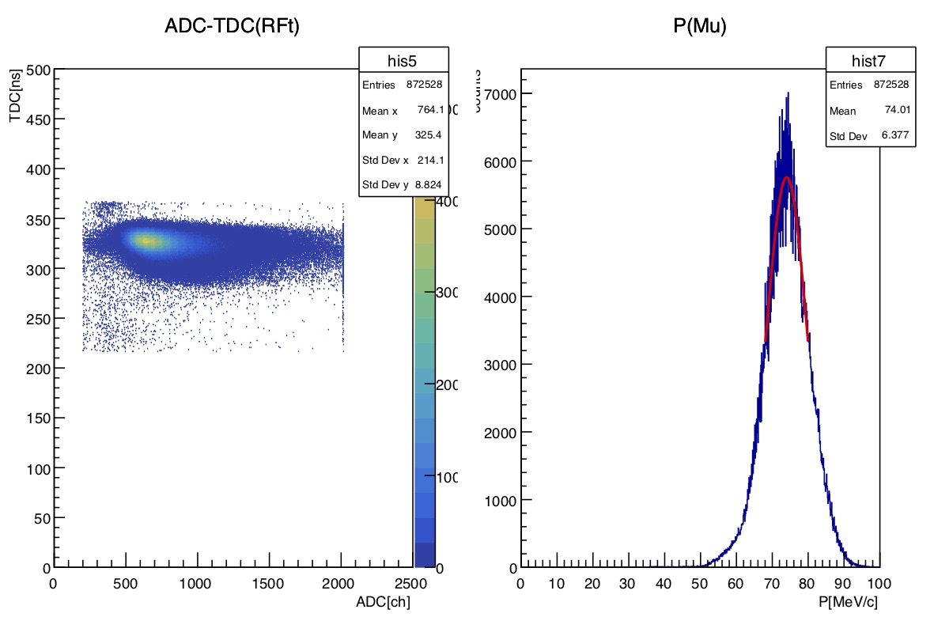
Momentum（ Suppose L=24.075m）
Magnets
40MeV/c
50MeV/c
60MeV/c
70MeV/c

Slide 10
Result
Magnets setting | TOF測定解析結果
Momentum [MeV/c] | Momentum [MeV/c] | Δp/p[％]
40 | 44.0 ±0.02 | 8.3
50 | 54.0 ±0.01 | 8.7
60 | 64.7 ±0.01 | 8.4
70 | 74.1 ±0.01 | 8.3
a little huge momentum
4〜5MeV/c
What’s thought to be the cause
① Uncertainty of the length of flight
② Uncertainty of the place of decay π→μ
③ Uncertainty of the direction of decay π→μ
→ I want to check the decay and length of flight by each event !!
→ Use simulations !!

Slide 11
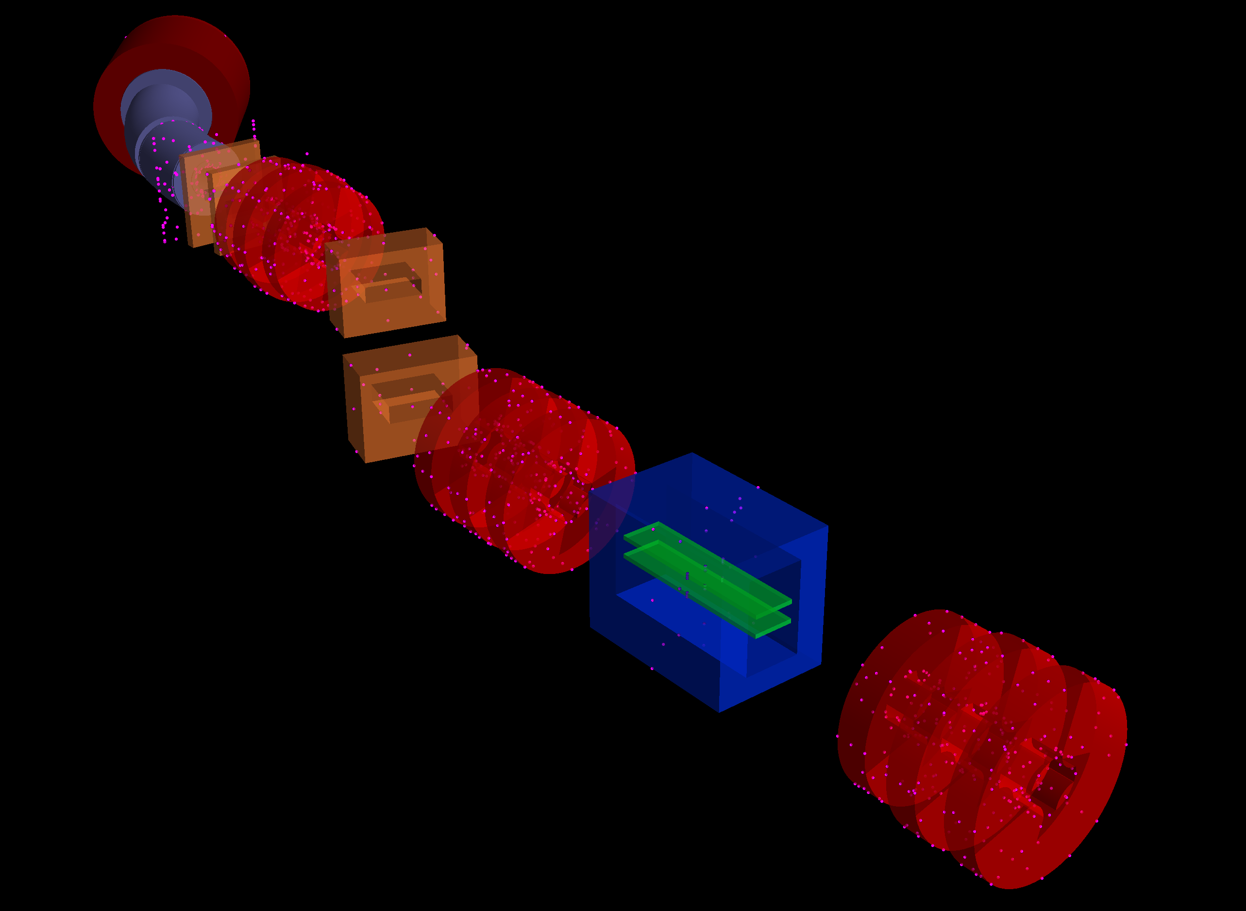
Simulation by G4-Beamline
・Reproduce MuSIC-Beamline
in G4Beamlie .
・Put Virtual detector at the same
place of scintillator .
・At first ,reproduce only
60 MeV/c magnets setting .

Slide 12
TOF of Muons
・At peak momentum , simulation data accords closely with the test data .
・The simulation data has a similar shape to the test data .
Test data (60 MeV/c)
Simulation data (60 MeV/c )

Slide 13
Momentum of muons
|
||
Test data (60 MeV/c) based TOF(L=24.075m)
Simulation (60MeV/c)

Slide 14
Pion decay point
Almost all Pion decay to muon at z<5000 mm
(The place of first Bending magnet Z~6000 )

Slide 15
Future
・I will consider the fact of the shape of momentum
distribution ,and how to cut .
・I will check the correlation of flight distance, TOF, and
momentum for each event to find the factors
that lead to the improvement of beam accuracy.
・I will simulate Other magnets setting case ,too.

Slide 16
予備スライド

