Slide 1
g-factor measurement with cosmic muon and measurement of muonic X-ray
Kuno and Yamanaka Group Year-End Presentation 2017
December 28th 2017
Hasuike Daishin Miyamoto Koichiro
Nishikawa Ryo Ohta Saki

Slide 2
content
g-factor measurement
Muonic X-ray measurement
Introduction
g-factor
Motivation
Cosmic muon
Charge ratio and polarization
Muon decay
Spin precession
Detection plan
How to identify muon?
Muon g-factor measurement
Design of the equipment & solenoid
Magnetic field distribution
Threshold determination
summery
Introduction
Motivation
Muonic atom and muonic X-ray
Semiconductor detector
Experiment
Selection of target
Setup
Design of target
What to do next
Summary
Back up

Slide 3


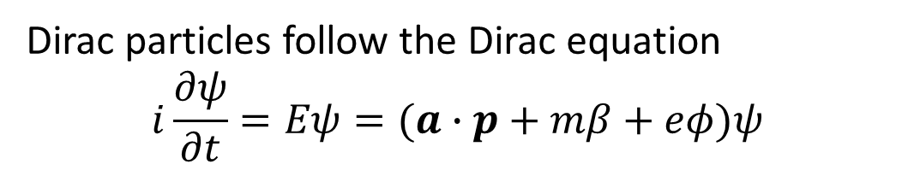
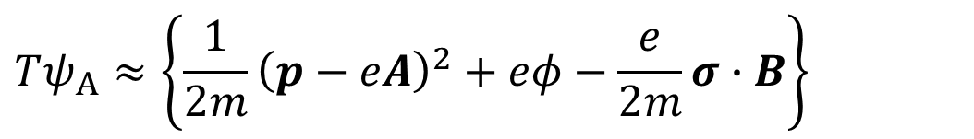
Introduction g-factor
Dirac particles follow the Dirac equation
$$i\frac{∂ψ}{∂t}=Eψ=(a∙p+mβ+eφ)ψ$$
From it we can obtain this
$$Tψ_{A}≈\left\{\frac{1}{2m}{\left(p−eA\right)}^{2}+eφ−\frac{e}{2m}σ∙B\right\}$$
Compared to Hamiltonian
$$\hat{H}={\hat{H}}_{0}−μ∙B$$
$$μ≈\frac{e}{2m}σ=2×\frac{e}{2m}\hat{s}=g\frac{e}{2m}\hat{s}$$
Therefore the value of g-factor is 2

Slide 4
But in reality, g-factor is not truly 2 because of quantum correction.
It called anomalous magnetic moment
Theoretical value 2.0023318361 ± 0.0000000010
Measured value 2.0023318414 ± 0.0000000012
The muon g-factor can be affected by physics beyond the Standard Model
High precision measurement is being done in all over the world
Of course , we can’t measure such a high precision, but we want to try it!
Notes:
どこのデータか書く
いまやってる実験
そこまで精度は出せないけどやってみたい←motivation

Slide 5
motivation
To measure muon g-factor with cosmic muon to the extend possible.
To increase accuracy twice as good as last year.
The value of g-factor measured last year
2.157±0.172
Reduce to half
Notes:
去年のデータ、改良予定点

Slide 6
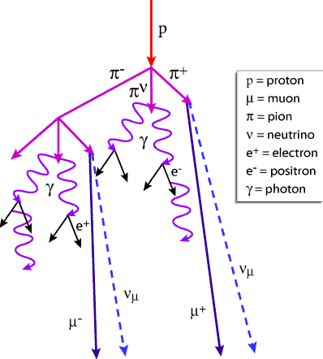
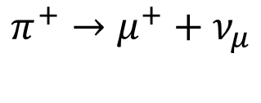

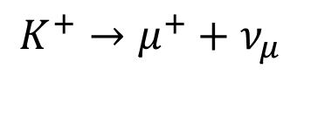

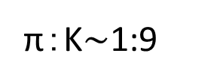
Cosmic muon
primary cosmic rays
90% are proton
Secondary cosmic rays
π, K, γ, etc.
positron
π±,K± decay into μ±
electron
$$π^{+}→μ^{+}+ν_{μ}$$
$$K^{+}→μ^{+}+ν_{μ}$$
$$π^{−}→μ^{−}+{\overline{ν}}_{μ}$$
$$K^{−}→μ^{−}+{\overline{ν}}_{μ}$$
Abundance ratio
π：K$\sim$1:9

Slide 7



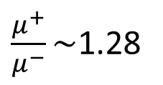
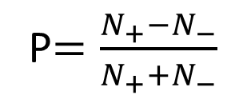





Charge ratio and polarization
Charge ratio of atmospheric muons
$\frac{μ^{+}}{μ^{−}}\sim$1.28
Rest frame of π
laboratory frame
Spin polarization ratio
$$μ^{+}$$
$$π^{+}$$
P$=\frac{N_{+}−N_{−}}{N_{+}+N_{−}}$
momentum
spin
$$π^{+}$$
or
$$N_{+}:$$
Number of up spin muon
$$μ^{+}$$
$$ν_{μ}$$
$$ν_{μ}$$
Depending on the decay direction, the spin direction of μ reverses
$$N_{−}:$$
Number of down spin muon
100% polarized

Slide 8
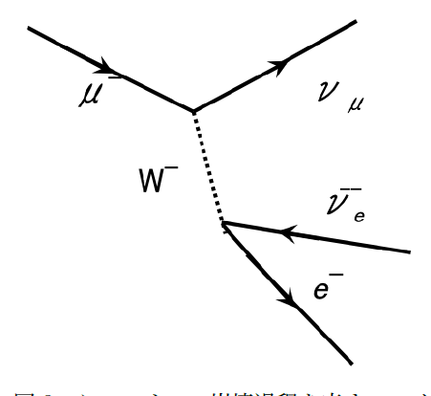
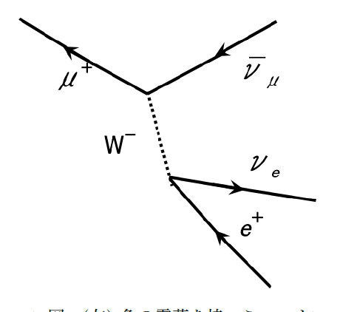


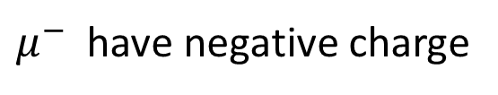


Muon decay
$$μ^{+}→e^{+}+ν_{e}+\overline{ν_{μ}}$$
$$μ^{−}→e^{−}+\overline{ν_{e}}+ν_{μ}$$
$μ^{−}$ have negative charge
Capture by nuclei
$$W^{+}$$
$$p+μ^{−}→n+ν_{μ}$$
Mean life time
2.2μs
Mean life time in copper
0.16μs

Slide 9
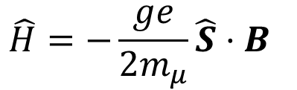
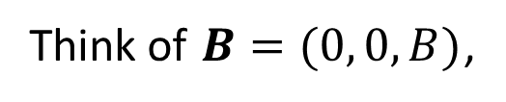
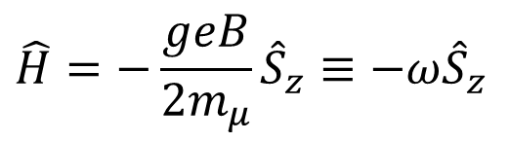
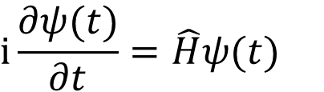

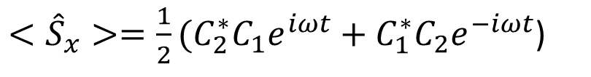
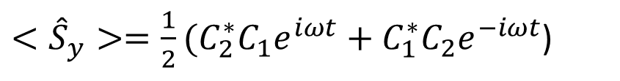
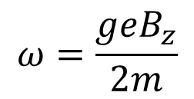
Spin precession
From this equation,
expected value can be calculated,
In natural unit,
interaction Hamiltonian is
$$\hat{H}=−\frac{ge}{2m_{μ}}\hat{S}⋅B$$
$<{\hat{S}}_{x}>=\frac{1}{2}(C_{2}^{∗}C_{1}e^{iωt}+C_{1}^{∗}C_{2}e^{−iωt}$)
$<{\hat{S}}_{y}>=\frac{1}{2}(C_{2}^{∗}C_{1}e^{iωt}+C_{1}^{∗}C_{2}e^{−iωt}$)
Think of $B=(0, 0,B)$,
$$\hat{H}=−\frac{geB}{{2m}_{μ}}{\hat{S}}_{z}≡−ω{\hat{S}}_{z}$$
$$<{\hat{S}}_{z}>=\frac{1}{2}{(|C_{1}|}^{2}−{\left|C_{2}\right|}^{2})$$
Therefore, spin precesses at angular velocity ω on xy plane
Schrödinger equation is given by
$$i\frac{∂ψ(t)}{∂t}=\hat{H}ψ(t)$$
$$ω=\frac{geB_{z}}{2m}$$
Notes:
歳差運動の図を入れる

Slide 10
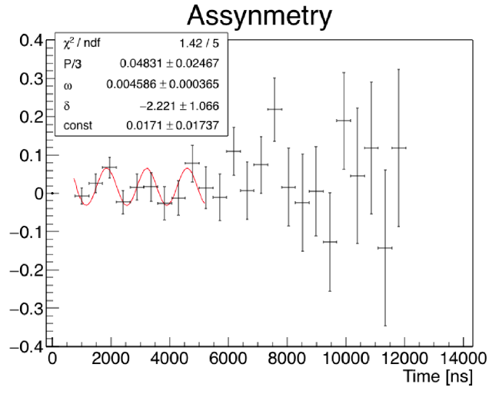
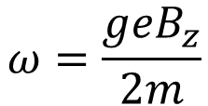
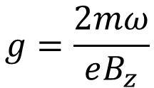
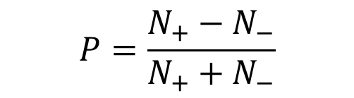
We measure B and ω
$$ω=\frac{geB_{z}}{2m}$$
$$g=\frac{2mω}{eB_{z}}$$
We can calculate g-factor
The electrons which come from muon decay are often go to the spin direction of muon.
The muons which stopped at the target in a magnetic field do spin precession, and released electrons through upper side or down side scintillator.
Last year measurement
$$P=\frac{N_{+}−N_{−}}{N_{+}+N_{−}}$$

Slide 11
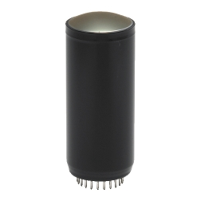
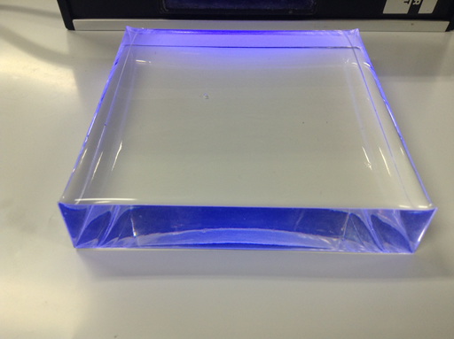
Detection plan
Cosmic rays
Detector(PMT)
How is the muon detected?
You can’t see it in your eyes...
Scintillatoｒ
γ
PMT
Plastic scintillator
Detect light signals by
PMT(PhotoMultiplier Tube)
when it goes through scintillators.
Source of pictures
PMT: https://www.hamamatsu.com/jp/ja/3001.html
Plastic scintillator: http://www.hep.sc.niigata-u.ac.jp/~vnd/
Notes:
ミューオンをどうやって検出するのか？
目には見えない→シンチを通過した時の光信号をフォトマルで見よう

Slide 12



How to identify the muon?
The muon penetrates scintillators easily, because it has heavier mass than other particles in the cosmic ray. So a signal detected by piled up scintillators is likely to be derived from the muon.
The muon decays to the electron and neutrinos with a mean lifetime of 2.2μs. If you detect a pair of signals with such an interval, there is a high possibility that you are seeing the decay event.
* It’s just made of acrylic resin and no fluorescence. We couldn’t get enough scintillation counters.
#1
PMT E, G
(1)
*
PMT F, H
Cherenkov counter
F
H
$$μ$$
What’s this?
(2)
#2
PMT A
$$e$$
PMT B
B
Cu plate
stop
decay
#3
PMT C
$$e$$
PMT D
D
(2)’
Notes:
ミューオンの判別方法
ミューオンは質量が大きく止まりにくいので、シンチを容易に貫通する。したがって、重ねたシンチでも検出できる信号はミューオンの可能性がある。
ミューオンは平均寿命2.2μsで電子とニュートリノに崩壊する。もしその間隔で一対の信号が検出できれば、ミューオンの崩壊事象を見ている可能性が高い。
#1: チェレンコフカウンタ ただのアクリル樹脂製で蛍光性はない。十分な数のシンチを用意できなかった。
#2,3: シンチレーションカウンタ
銅板（ストッピングターゲット）
#1と#2,3の間を空けることで、銅板に当たらないスタートトリガーの数を減らせる

Slide 13



How to identify the muon?
(1) $\#1∩\#2∩\#\overline{3}$
Start trigger
Interval=2.2μs
(2) $\#\overline{1}∩\#2∩\#\overline{3}$
OR
Stop trigger
It’s the muon.
(2)’ $\#\overline{1}∩\#\overline{2}∩\#3$

Slide 14

Muon g-factor measurement
Electrons after muon will be alternately detected by the upper and lower scintillators when putting the stopping target(Cu plate) into magnetic field.
→ g-factor can be obtained from the frequency of detecting cycle ω.
$$g=\frac{2m_{μ}ω}{eB}$$
scintillator
S
μ
ω
Cu
S
B
scintillator
e
Notes:
弱い相互作用におけるパリティ対称性の破れにより、電子はスピンと同じ方向に放出されやすい
スピンは磁気モーメントとともに回転するので、適切な磁場をかければ上下のシンチで交互に電子が検出される
→電子の検出周期からg因子が求められる

Slide 15
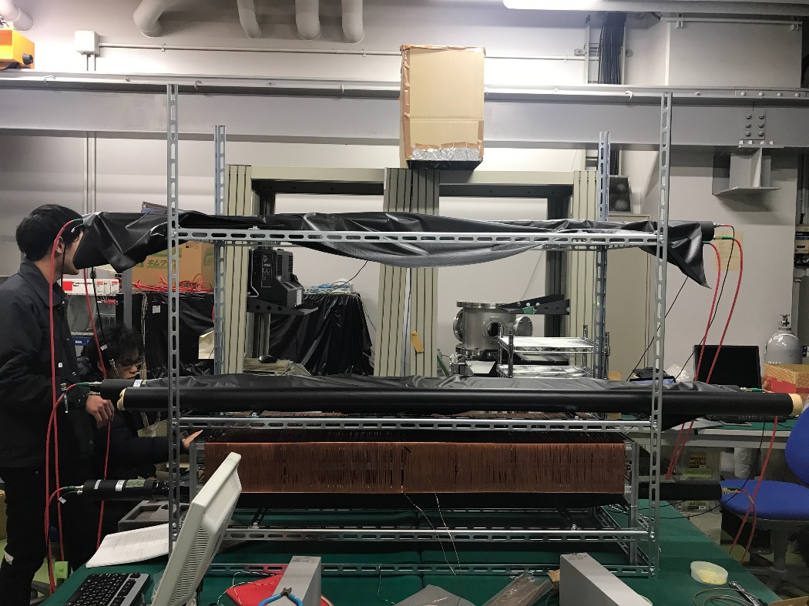
Design of the equipment
Cerenkov counter
solenoid
Scintillation counter
 | Cerenkov counter | Scintillation counter | Cu plate
Length[cm] | 140 | 100 | 25
Width[cm] | 10 | 20 | 25
Height[cm] | 4 | 5 | 0.5×2 double-coursed
number | 2 | 2 | 6

Slide 16
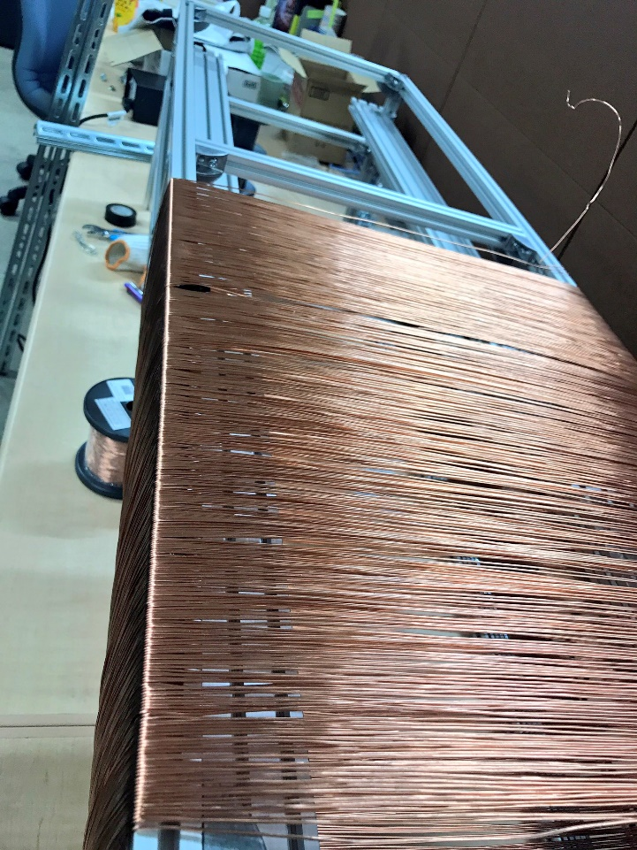
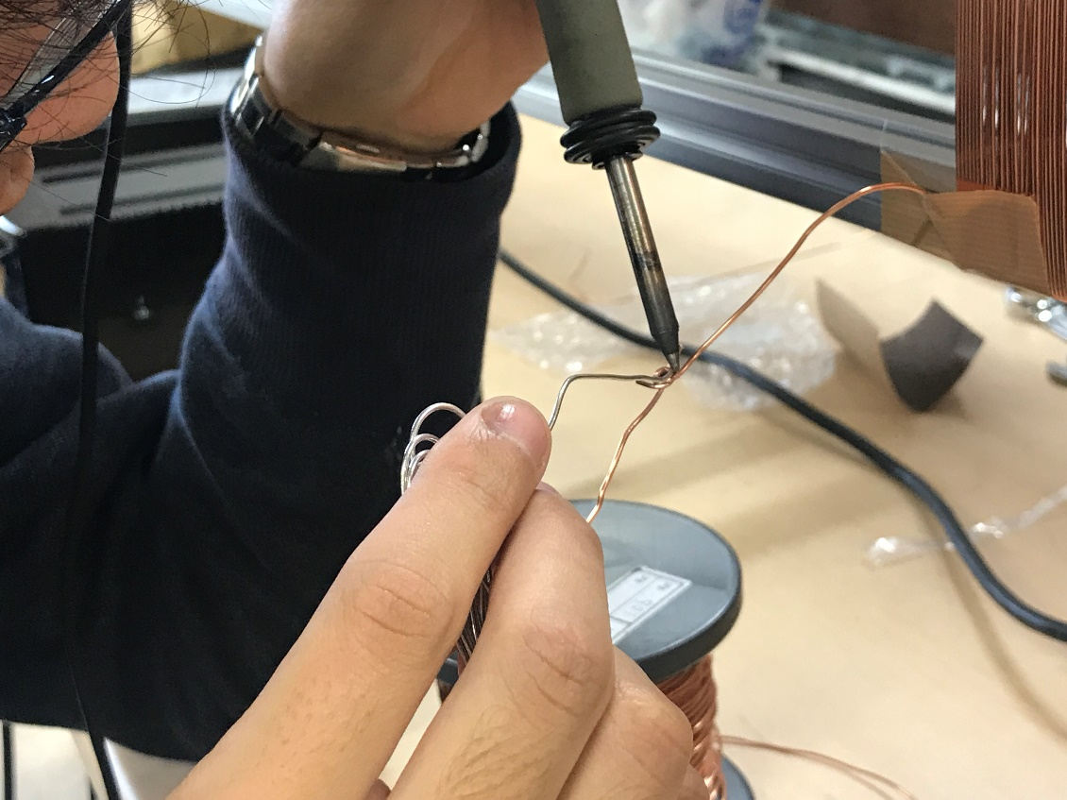
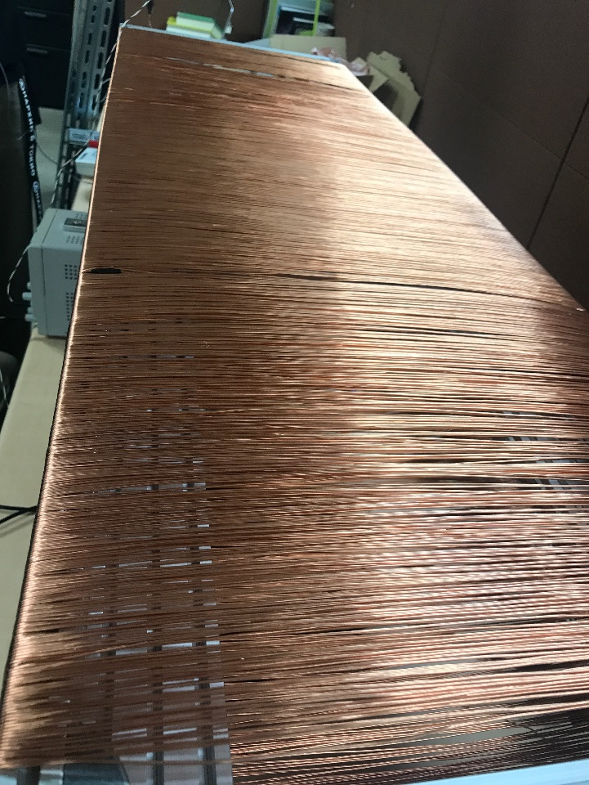
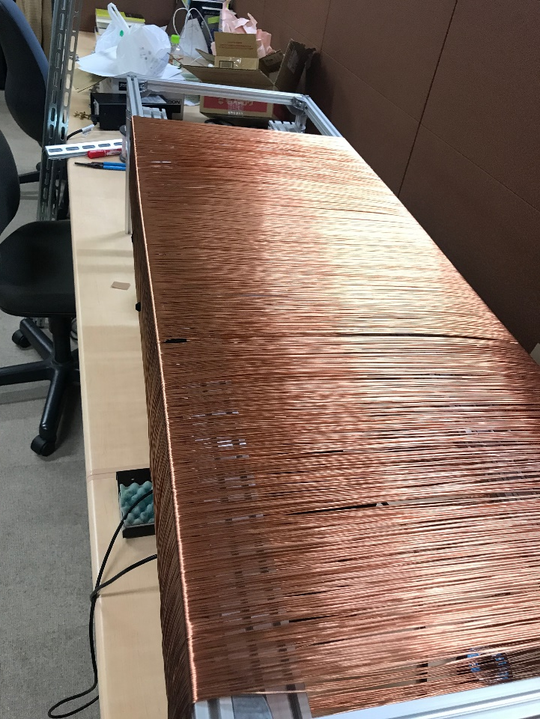
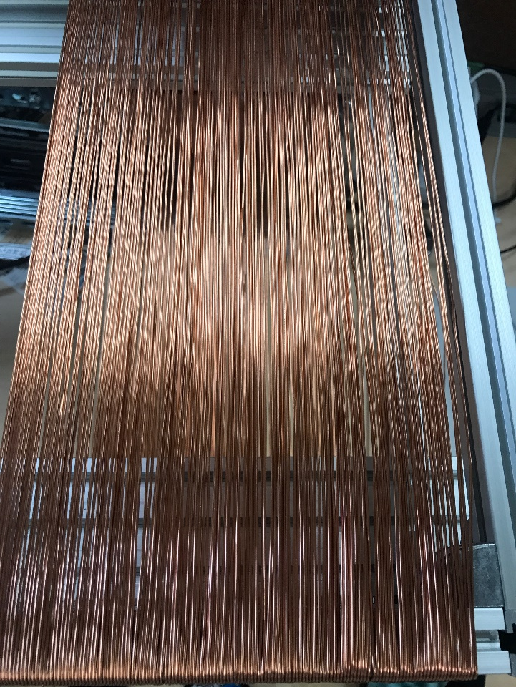
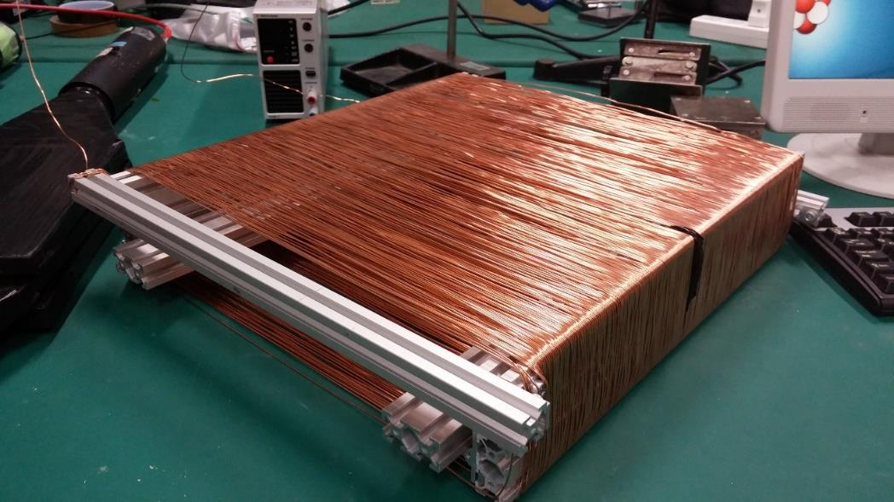
Design of the solenoid
We enlarged a solenoid to almost four times in order to adapt for the size of scintillators.
It also contributes to homogeneity of magnetic field.
This year
 | Last year | This year
Length[cm] | 38 | 116
Width[cm] | 36 | 39
Height[cm] | 8 | 14
Number of turns | 340 | 1104
Current[A] | 5.002 | 5.00
Last year
Notes:
コイルの設計
シンチレータのサイズに合わせてコイルを大型化した
大型化は磁場の一様性にも寄与する

Slide 17
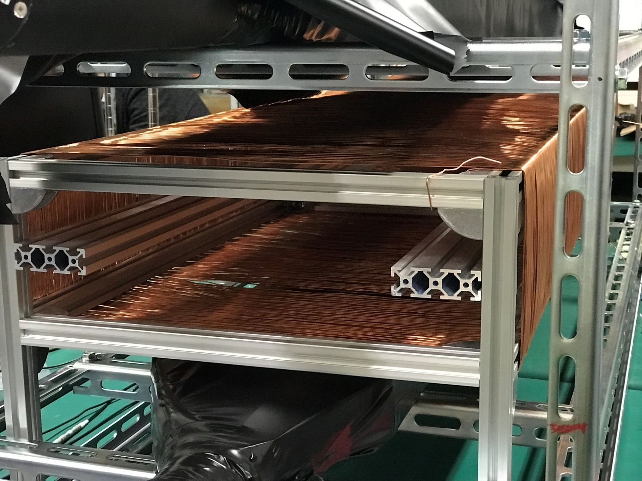
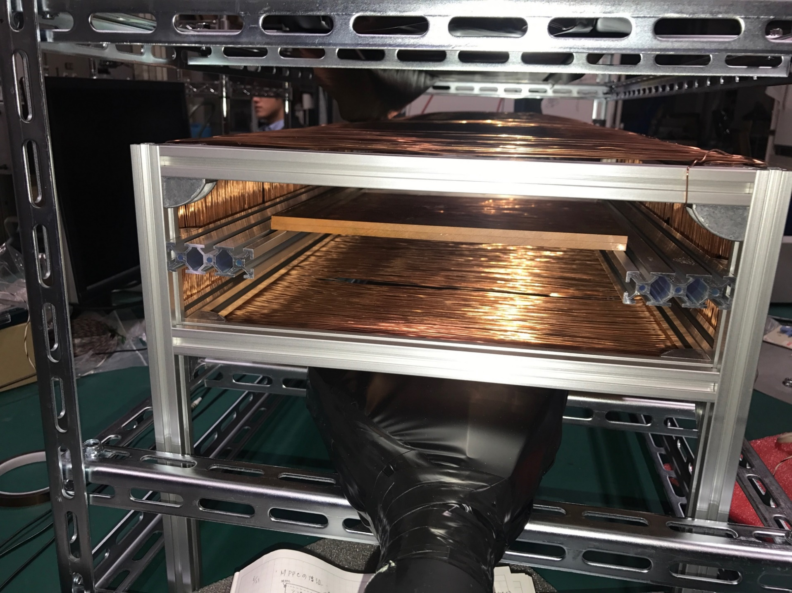
Design of the solenoid

Slide 18
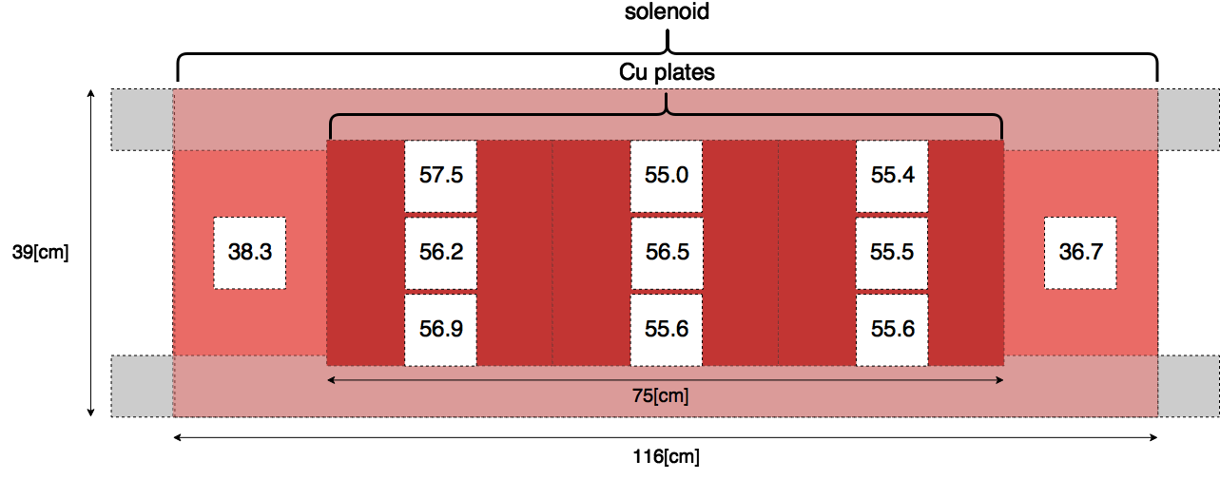
Magnetic field distribution
Magnetic field intensity(unit: [G]) was measured using a Hall probe.
The intensity of the central magnetic field was determined based on the amount of current used in the experiment of last year.

Slide 19
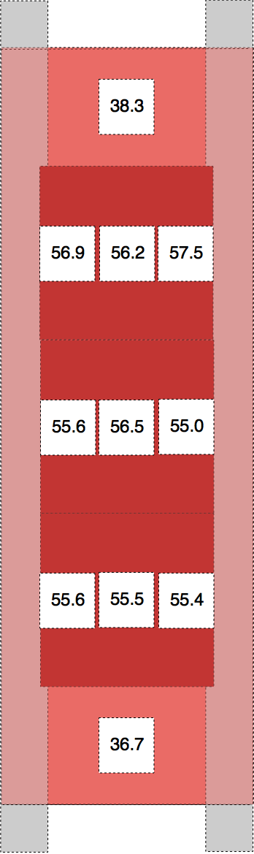
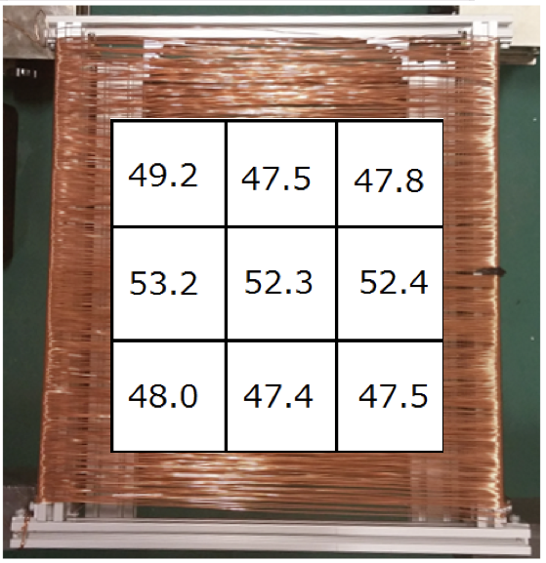
Magnetic field distribution
B
Last year
B
This year
38[cm]
116[cm]

Slide 20
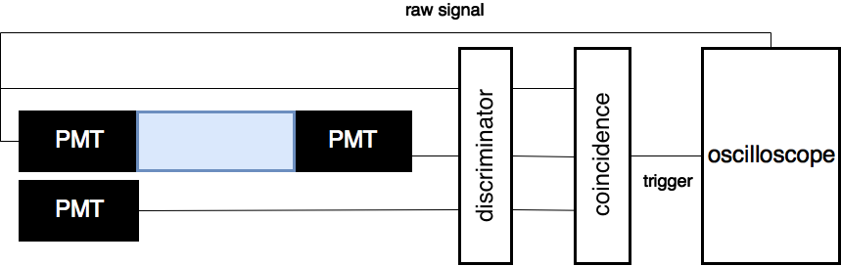
Threshold determination
A histogram of the raw signal pulse height from PMTs was made using the following circuit, and the discriminator threshold was determined.
Simultaneous noise was excluded by setting the coincidence signal as trigger.
The threshold was set to the lowest level during this measurement.
Threshold determining logic circuit

Slide 21
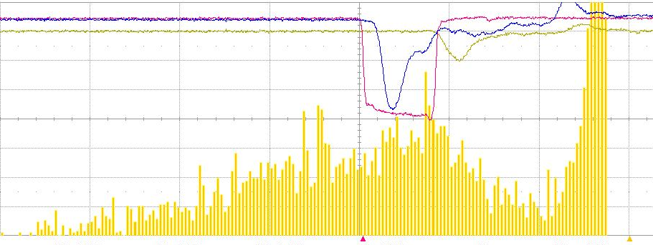
Threshold determination
Histogram of raw signal pulse height
: raw signal
: trigger signal
count
noise
Pulse height [mV]
-20
0
 | Applied voltage [V] | Threshold [mV] |  | Applied voltage [V] | Threshold [mV]
PMT A | 1790 | 500 | E | 2300 | 20
B | 1900 | 500 | F | 2100 | 20
C | 1865 | 500 | G | 2100 | 20
D | 1845 | 500 | H | 2100 | 20

Slide 22
Summery
We want to try measuring muon g-factor with a cosmic ray.
The goal is to achieve twice the accuracy higher than last year.
The equipment is enlarged three times larger.
What to do next…?
Begin to take data with applying magnetic field
Error analysis and demonstration of its reduction
Solid angular last year×1/2
Size of target last year×3
Data taking time last year×1.5
uniformity of magnetic field last year×2
Total
halve the error

Slide 23
Measurement of muonic X-ray with cosmic muons

Slide 24
Motivation
●Recently, it seems to be popular to perform elemental analysis using muon in physical industry.
●We would like to touch cutting-edge research to the extent possible.
●It would be interesting that we can do element analysis with cosmic rays.

Slide 25
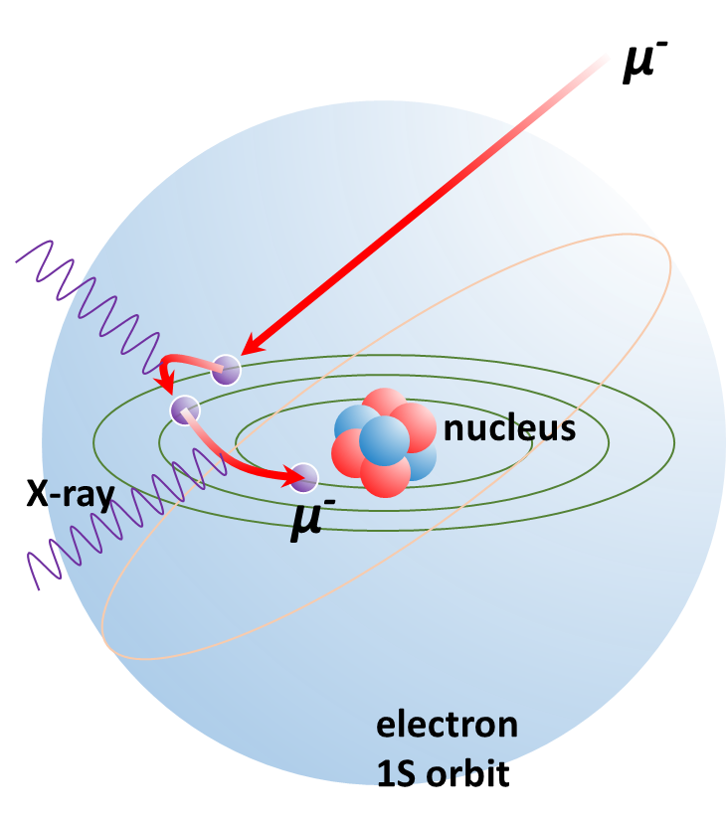

Muonic atom
Atomic bound states formed by a negative muon and a nucleus
Bohr model
$$r_{ n}=\frac{ε_{0}n^{2}h^{2}}{Zπm_{e}e^{2}}$$
$$E_{ n}=−\frac{Z^{2}m_{e}e^{4}}{8ε_{0}^{2}n^{2}h^{2}}$$
$$\frac{r_{μ}}{r_{e}}=\frac{E_{e}}{E_{μ}}=\frac{m_{e}}{m_{μ}}≈\frac{1}{207}$$
$$Al 1S orbit r≈1.97×{10}^{−14}(m)$$
It takes ${10}^{−13}\sim {10}^{−14}$sec to transition to the ground state

Slide 26
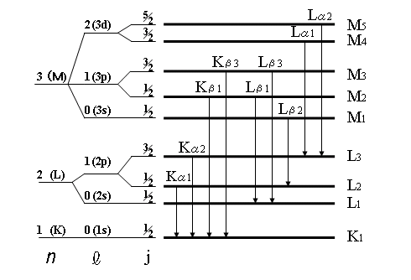
Muonic X-ray
μ⁻ is captured by an atom
Emit muonic X-rays with an energy level equivalent to the energy difference between the higher and lower states
The energy is characteristic to the element
Characteristic X-Ray Energies

Slide 27
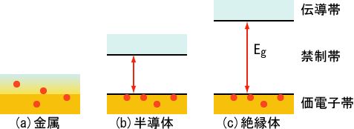
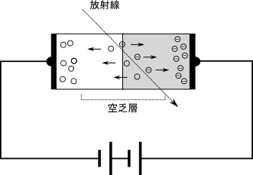
Operating principle of semiconductor detector
Conduction band
Forbidden band
radiation
Valence band
metal
semiconductor
insulator
$$n=\frac{E}{ε}$$
Depletion layer
n : the number of electron-hole pair to be generated
E : the energy of radiation absorbed in semiconductor
ε : the required energy to generate a electron-hole pair

Slide 28
Germanium detector
●Advantage
・High energy resolution
●Disadvantage
・Cooling required
GMX20P4-70

Slide 29
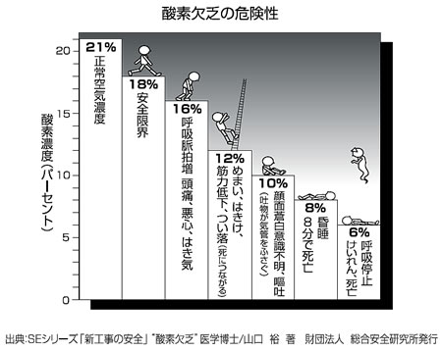
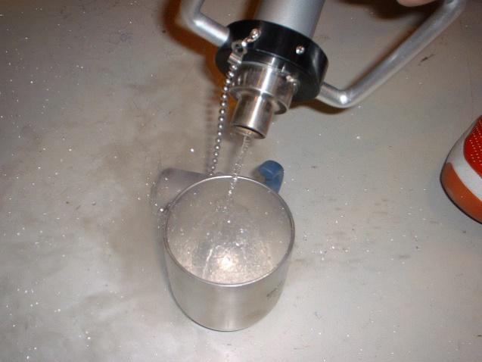
Liquid Nitrogen
（https://www.rex-rental.jp/anz/xo-326-2sa.htmlより参照）
●Leave the underground laboratory immediately when there is an alarm.
●Don’t enter the lab room if the lamp near the door is lit.
●Please follow instruction of kuno lab staff when abnormality occurs.

Slide 30
Selection of Target
We are satisfied if we can see the characteristic x-rays with cosmic rays.
It seems that aluminum is used as target in COMET.
Let’s experiment with the same as COMET.
Later, let’s see how the difference in purity contributes to the spectrum of x-ray.

Slide 31
Setup
$$μ^{−}$$
Pre Amp
Scinti 1
target
X-ray
Ge
Dewar
Amp
MCA
Scinti 2
HV
target
Ge
X-ray
Scinti 3
Scintillator size : 20cm×20cm
trigger
$$1∩2∩\overline{3}$$

Slide 32
Design of target
●Plan A
●Plan B
Al
Ge
Al
Ge
28cm
Y cm
20cm
20cm
28cm
X cm

Slide 33
Design of target
About Y
The larger Y is,
the better stop rate is.
(Roughly proportional relation)
About X
Scinti 2
X and stop rate are proportional relations.
(X is up to 20cm,
because of scintillator size.)
Al

Slide 34
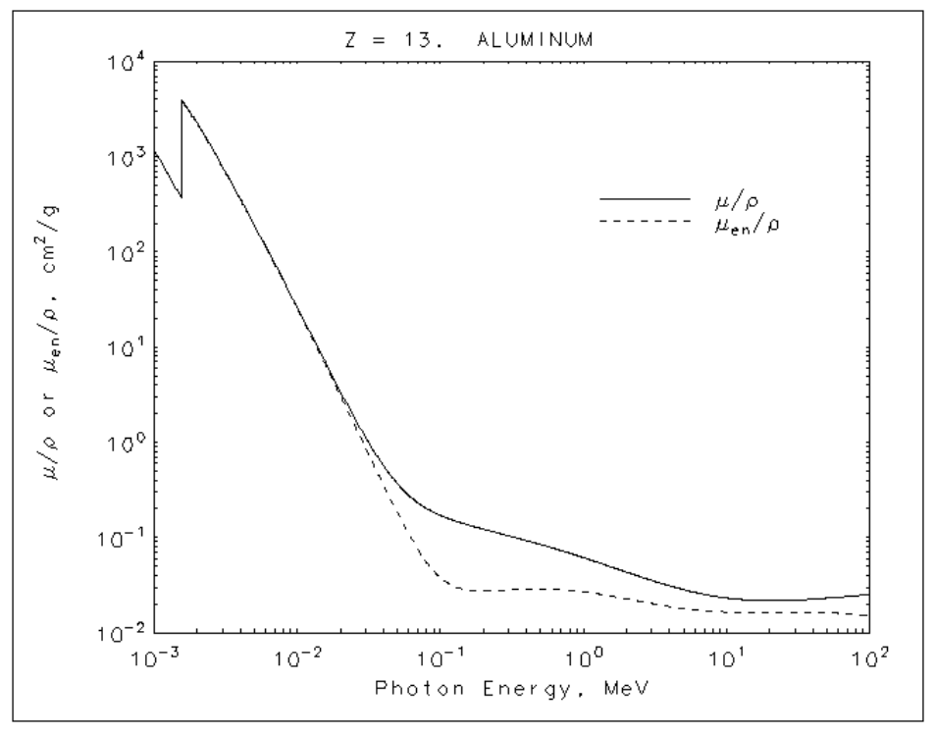




Design of target
About X
Intensity follows this formula
$$K_{α}=347 [keV]$$
$$I=I_{0}e^{−μ_{m}x}$$
$μ_{m}$:mas attenuation coefficient
$$μ_{m}=0.1$$
The intensity of x-rays emitted from the aluminum surface is 1.

Slide 35
Design of target
About X
$$f\left(x\right)≡(stop rate) ×(ave Intensity)$$
The greater X, the better.
So, X should be 20cm.
But, there is cost problem.
Notes:
20*20*3 7.8000円

Slide 36
What to do next
●Measure efficiency of Ge detector.
●Perform energy calibration of MCA.
●Prepare target as soon as possible.

Slide 37
Summary
●We wanted to see muonic x-rays with cosmic rays.
●We decided aluminum as the target.
●We thought about the shape of target.
●We have to get to the experiment early.

Slide 38

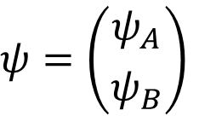
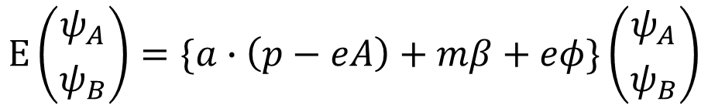
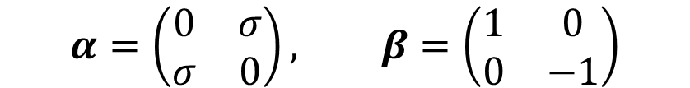

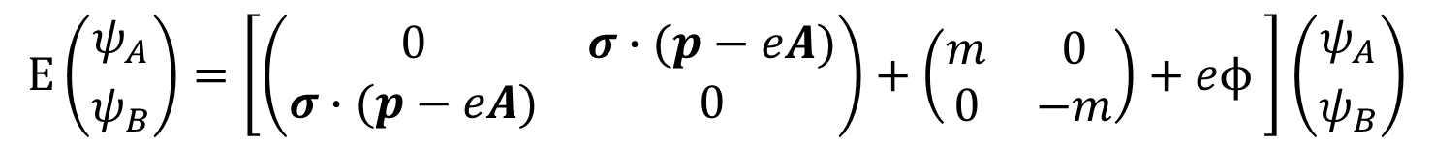
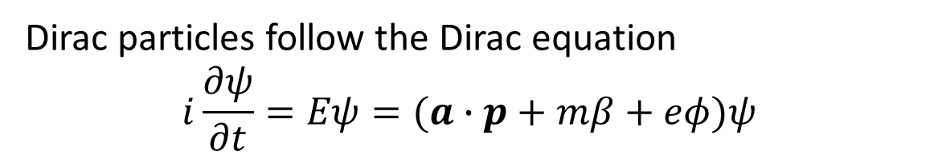
Backup g-factor
Dirac particles follow the Dirac equation
$$i\frac{∂ψ}{∂t}=Eψ=(a∙p+mβ+eφ)ψ$$
Add the electromagnetic field${ A}^{μ}$、$p^{μ}→p^{μ}−eA^{μ}$
$$Eψ=\{a∙\left(p−eA\right)+mβ+eφ\}ψ$$
Disassemble $ψ$
$$ψ=\left({ψ_{A} \atop ψ_{B}}\right)$$
$$E\left({ψ_{A} \atop ψ_{B}}\right)=\{a∙\left(p−eA\right)+mβ+eφ\}\left({ψ_{A} \atop ψ_{B}}\right)$$
Pauli-Dirac display
$$E\left({ψ_{A} \atop ψ_{B}}\right)=\left[\left(\begin{matrix}0 & σ∙(p−eA) \\ σ∙(p−eA) & 0\end{matrix}\right)+\left(\begin{matrix}m & 0 \\ 0 & −m\end{matrix}\right)+eϕ \right]\left({ψ_{A} \atop ψ_{B}}\right)$$
$$α=\left(\begin{matrix}0 & σ \\ σ & 0\end{matrix}\right), β=\left(\begin{matrix}1 & 0 \\ 0 & −1\end{matrix}\right)$$

Slide 39







$$\left(E−eφ−m\right)ψ_{A}=σ∙(p−eA)ψ_{B}$$
$$\left(E−eφ−m\right)ψ_{B}=σ∙(p−eA)ψ_{A}$$
(1)
(2)
Non-relativity approximation $E=T+m$
$$T≪m, eφ≪m$$
$$E−m−eφ=T−eφ$$
$$E+m−eφ=2m+T−eφ≈2m$$
Assign to (2)
$$ψ_{B}≈\frac{σ∙(p−eA) }{2m}ψ_{A}$$
Substitute for (1)
$$\left(T−eφ\right)ψ_{A}≈\frac{\left[σ∙\left(p−eA\right)\right]∙[σ∙\left(p−eA\right)]}{2m}ψ_{A}$$

Slide 40




Deforming the numerator
$$\left\{{\left(p−eA\right)}^{2}+iσ∙ieB\right\}ψ_{A}$$
B : Magnetic flux density
finally
$$Tψ_{A}≈\left\{\frac{1}{2m}{\left(p−eA\right)}^{2}+eφ−\frac{e}{2m}σ∙B\right\}$$
Compared to Hamiltonian
$$\hat{H}={\hat{H}}_{0}−μ∙B$$
$$μ≈\frac{e}{2m}σ=2×\frac{e}{2m}\hat{s}=g\frac{e}{2m}\hat{s}$$
Therefore the value of g-factor is 2

Slide 41



The electron distribution given by the V-A theory is
$$ρ\left(X,cosθ\right)=2X^{2}\left[\left(3−2X\right)+\left(2X−1\right)Pcosθ\right]$$
Where $X=\frac{E}{E_{max}}$
$θ$ is the angle of electron emission with respect to the muon polarization vector
P is polarization ratio
Notes:
グラフタイトル追加
式の部分改良

Slide 42
Back up
厚さ | rate | intensity | ave int | rate*aveint
0 | 0 | 1
1 | 0.05 | 0.951229 | 0.952022 | 0.047601
2 | 0.1 | 0.904837 | 0.907101 | 0.09071
3 | 0.15 | 0.860708 | 0.865018 | 0.129753
4 | 0.2 | 0.818731 | 0.82557 | 0.165114
5 | 0.25 | 0.778801 | 0.788572 | 0.197143
6 | 0.3 | 0.740818 | 0.75385 | 0.226155
7 | 0.35 | 0.704688 | 0.721246 | 0.252436
8 | 0.4 | 0.67032 | 0.690611 | 0.276244
9 | 0.45 | 0.637628 | 0.661809 | 0.297814
10 | 0.5 | 0.606531 | 0.634714 | 0.317357
11 | 0.55 | 0.57695 | 0.609208 | 0.335065
12 | 0.6 | 0.548812 | 0.585185 | 0.351111
13 | 0.65 | 0.522046 | 0.562543 | 0.365653
14 | 0.7 | 0.496585 | 0.54119 | 0.378833
15 | 0.75 | 0.472367 | 0.521039 | 0.390779
16 | 0.8 | 0.449329 | 0.50201 | 0.401608
17 | 0.85 | 0.427415 | 0.484031 | 0.411426
18 | 0.9 | 0.40657 | 0.467031 | 0.420328
19 | 0.95 | 0.386741 | 0.450948 | 0.4284
20 | 1 | 0.367879 | 0.435721 | 0.435721

Slide 43
Contents
●Introduction
・Motivation
・Muonic atom and muonic X-ray
・Semiconductor detector
●Experiment
・Selection of target
・Setup
・Design of target
●What to do next
●Summary
●Back up

