Slide 1
Fundamental Physics of Muonic Atoms with a Muon-Ion Merged-Beams Method 合流法を用いたミューオニック原子・イオンの生成と基礎物理 Takahisa Itahashi ¹⁾, Akira Sato¹⁾, Dai Tomono²⁾, Keiji Takahisa²⁾ and Yoshitaka Kawashima²⁾ and Hideyuki Sakamoto³⁾ , Trin Hoa Lang ⁴⁾, Chau Van Tao ⁴⁾ 1) Graduate School of Science, Osaka University 2) Research Center for Nuclear physics, Osaka University 3) RIKEN Kobe 4) Science Univ. HCM, Vietnam
１．目的、
２．低速、高輝度化について
３．ミューオニック原子について
４．オージェー電子について
５．合流法について
６．将来展望とまとめ
Motivation
Deceleration of μ⁺ and μ⁻
Frictional cooling---Simulation
Muonic Atoms – Production
X-ray and Auger electron meas.
Merging and Colliding
Perspective for the experiment
Proposal

Slide 2

Muon Problems(?) :there are several discrepancies between experiment and theory in the muon sector (CODATA)
Experiments | Discrepancies | References
a_{μ} | 2.9σ | Phys. Rev D73
r_{p} | 7σ | Science 339 Annals Phys. 331
R_{k} B⁺->K⁺μ⁺μ⁻ | 2.6σ | P.R.L. 113.15
h -> μτ | 2.5σ | CMS colllab.
BSM ?
EDM ?
g-2 ?
cLFV ?
Dark matter ?
Gravity ?
Relativity ?
present quest in high energy physics and astrophysics
models at hidden sector
mediator of a new force
HPS 10 ~ 1000 MeV assume a new mediator
Possibilities
-New Physics-

Slide 3

Motivation – True muonium
particle –anti-particle
e⁺ - e⁻ :positronium
μ⁺ - e⁻ :muonium
π⁺ - π⁻ :pionium
p - $\overline{p}$ : protonium
$\overline{p}$ - ³He :anti-protonic
μ⁺ - μ⁻ :True muonium
CP
QCD
QED
Quantum Photonic Study
Basic Physics
(Hyper) Fine structure
Fundamental constants
not observed

Slide 4
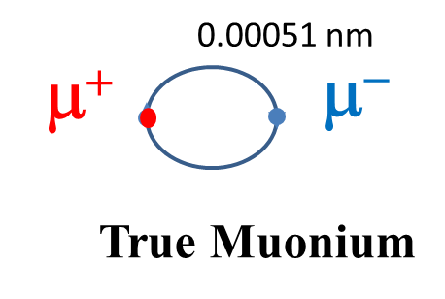
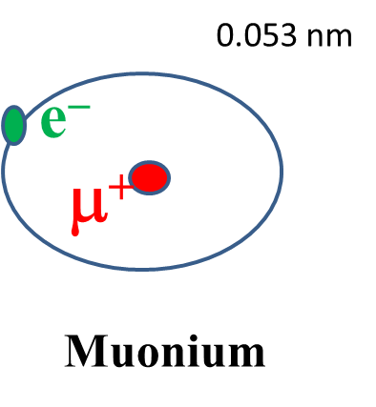
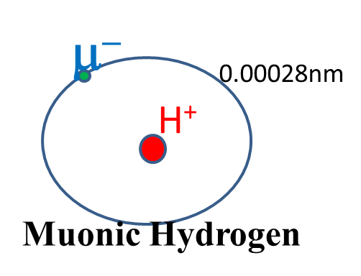
Smallest QED (leptonic) Atom – True Muonium
0.106 nm
e⁺
e⁻
Positronium

Slide 5

Hydrogen
3²D_{5/2}
pure leptonic atom
3²P_{3/2}
large reduced mass
3²S_{1/2}
3²D_{3/2}
103.4 m_{e}
0.5 m_{e}
3²P_{1/2}
μH
Positronium
True Muonium
2²P_{3/2}
2³S₁
2³P₂
2²P_{3/2}
2³P₂
2¹P₁
2¹P₁
2³P₁
2²P_{1/2}
2³P₀
2²S_{1/2}
2³P₁
2²S_{1/2}
2³S₁
2²P_{1/2}
2¹S₀
2³P₀
2¹S₀
Lamb shift
n=2 levels in muonic hydrogen, positronium and true muonium
1²S_{1/2}
n = 3 levels in hydrogen
True Muonium

Slide 6
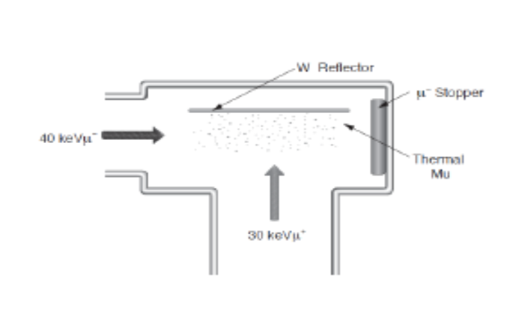
How do we produce the true muonium ?
High energy
Low energy
Heavy Photon Sear
K. Nagamine
Possible experimental arrangements; detection of formation by K. Nagamine appeared in USM 2013 at Matsue μ− + Mu -> (μ+μ−) + e-
Dimeson relativistic atom complex

Slide 7
低速・高輝度化の研究 Low energy and high brightness for muons
素粒子物理・基礎物理（BSM, BASIC & QUANTUM PHYSICS)
MLF– g-2/EDM
PSI -- MUSE
ILC beyond
ミューオンコライダー(Muon collider)
MICE Ionization cooling
MAP Helical cooling

Slide 8
Bright muon sources at low energy Hμ, Dμ, Heμ, experiments
100 MeV/c pion
Anti-cyclotron
MeV -> keV
20 keV
PSI ⇒
a few keV with a frictional cooling
hep-ph arXiv 502.05314v1 18 Feb 2015

Slide 9
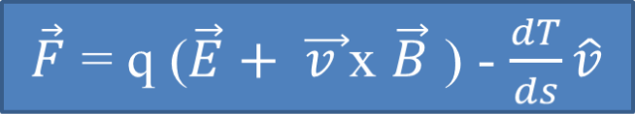
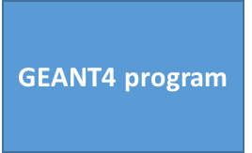

Frictional cooling
Local density approx. for a free electron gas
Strategy for a true muonium production via a low energy collision with μ+ and μ-
Many electrons configuration in matter
Frictional cooling
Dielectric response
Frictional force
--Lindhard, Scharff (1954)
T is kinetic energy
MICE
proportional to v
Free electrons
< 1 MeV/c
Frictional ECR SHeet – FRESH

Slide 10
Stopping power in low velocity region (Fujimoto15 p103 ) v velocity of particle: where v_{b} is Bohr velocity region I v >> v₀ ~ v_{b} Z₂^{2/3} region II v ~v₀ regonIII v<v_{o}
V₀ ：外殻電子の速度
Nuclear collision
Collision with electrons
dE/dx
II
I
III
Bethe Bloch
Inner shell correction
v₀
v

Slide 11
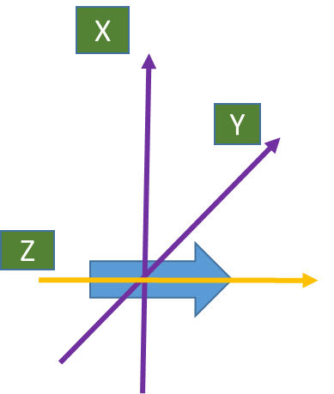





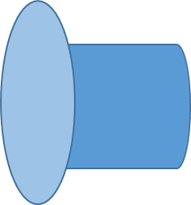
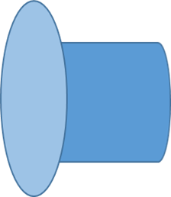






GEANT4 Simulation of proton beam emittance and energy spread for potential value
GEANT4 Simulation
Carbon
Helium
Hydrogen
Plasma
Carbon foil moderator and E field
plane-1
plane-2
plane-3
plane-4
plane-5
plane-6
plane-7
plane-8
plane-9
plane-10
E1
E6
E7
E8
E9
E10
Foil-6
Foil-7
Foil-8
Foil-9
Foil-10
proton 35 keV
2mm x 2mm parallel
carbon foil, 10 μg/cm2
(Solenoid: constant longitudinal B field)

Slide 12
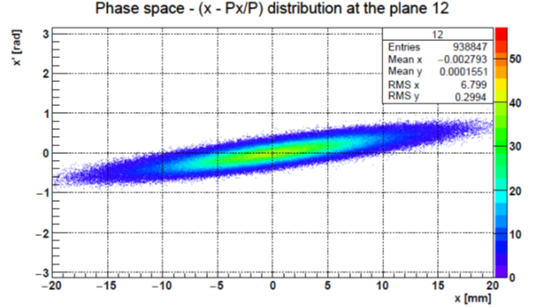
GEANT4 Simulation
35 keV
減速
加速
deceleration with thin foils
acceleration with potential
Energy of （proton） beam
optimization
iteration
20 keV

Slide 13

Thermalization of muons in solids
μ⁻
Negative muon interaction with matter
~50 MeV
decelerated
scattered & ionized
interact with atomic electrons
muonic atom formed
auger electrons emitted and radiative transition
muonic atom grand state
muon decay and radiative capture by nuclei happened
electron magneto-scattering
capture depends on spin
spin orbit interaction
atomic transition
hyperfine interaction
other depolarization due to solid materials
~3 keV
~1 ps
~2.2 ~0.05 μs

Slide 14
素過程 集団的、準粒子、フォノン、マグノン、プラズモン、ポラリトン、ロトン
Various phenomena
Quasi-particle
Phonon
Magnon
Poraliton
Roton
物質中では多彩な物理過程
物性物理学
電子の多体効果
ミューオン科学
ミクローマクロ
macroscopic ---microscopic

Slide 15
present research: to understand the energy dissipation mechanism ; capture of negatively charged muons by atomic or molecular systems and muonic cascade transition in detail
μ⁻
to do that, isolated muonic atoms are needed, if possible in vacuum
if dense targets, like solid materials are used: electrons are refiled which blinds initial state of capture
not macroscopic studies; cross section should be measured for single collision with target atom or ion
single collision properties would provide the various physics in macroscopic behavior
basic processes for collision physics

Slide 16
負ミューオン(μ-)ー原子イオン(ion) 基礎過程の研究
脱励起(Deexcitation)－－X-線の測定 X-ray meas.
脱励起ー－Auger電子の測定 Auger electron meas.
エントリーライン(entry)、主量子数(n)、軌道角運動量(l)
原子イオンの荷電状態(electron config.)、遮蔽の効果(screening)
放射再結合の断面積σ(E)の測定(radiative recombination) ;衝突エネルギー(collision energy) 精密可変
時間微分型の測定(differential) ~1 psec ~0.1 μs
X-線の精密測定と励起順位寿命の測定(energy & lifetime) ー＞ミューオニック原子からのX線のドップラーシフトの測定 (x-ray Doppler shift)
自由電子との衝突( in plasma)

Slide 17
Fundamental Physics of Muonic Atoms with a Muon-Ion Merged-Beams Method
Negative muons and atomic ions
High luminosity with capillary and channeling with crystal
Variable collision energy (two beam merge)
Selective charge state (variable collision E)
Entry point n and l (variable collision E)
Muonic X-ray and level lifetimes (recoil distance)
Auger electron (high resolution )

Slide 18
X-ray from exotic atom Ar+pbar

Slide 19
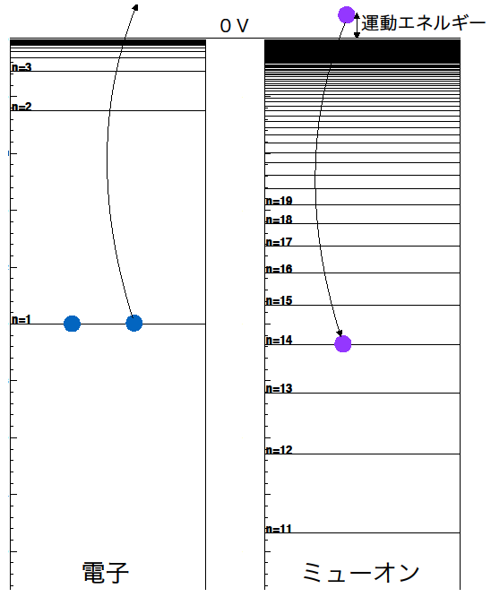
Muonic X-ray and Auger electron
ref. A. Shinohara K. Ninomiyaめそん４２（２０１５）ｐ２５
?
electron orbit
muon orbit

Slide 20
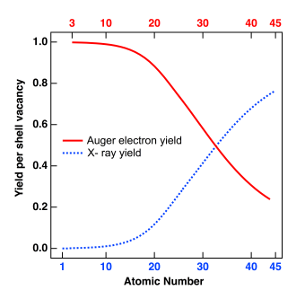
蛍光X線放出確率(X-ray emission )とオージェー電子放出確率(Auger electron emission )（内殻の電離に伴って外殻軌道からの電子遷移ーー蛍光X線放出過程及び外殻軌道上にある別の電子のイオン化に用いられる)。これらの確率は空孔を有する原子のZ, 順位の深いほどX線放出確率が高くなる。副殻間の遷移で起こる場合（コスタークローニッヒ遷移）

Slide 21
Principal quantum number n distribution (integrated over capture collision energies) the distribution was obtained at a time of ~0.3 ps after arrival of the projectile at the target. At the peak both electrons are ionized , but in the region of the shoulder and higher some atoms remain an electron
J.S.Cohen, Phys. Rev. 62 022512

Slide 22
The l distributions for p-bar-α (n=34) and μ-α (n=12) integrated over capture energy are shown.
n=34 and n=12 the most probable value of n in n-distribution
J.S.Cohen, Phys. Rev. 62 022512

Slide 23
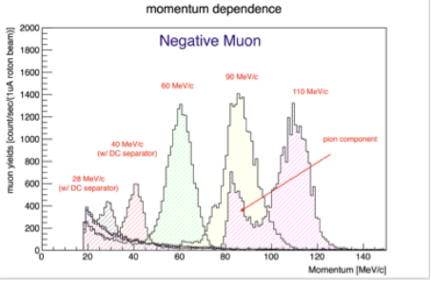

Slide 24
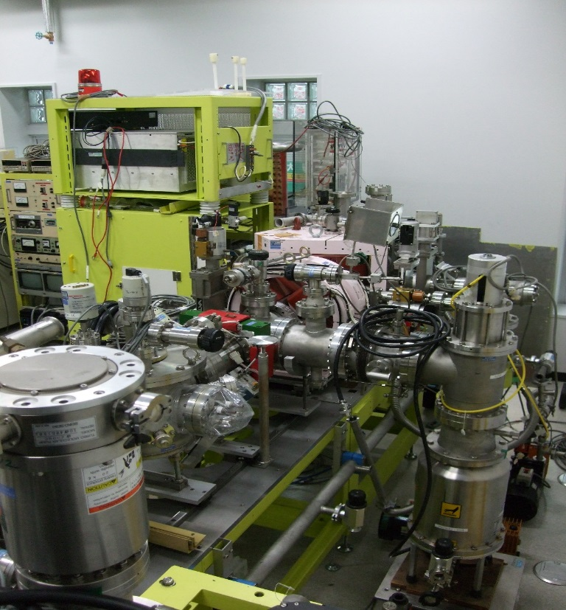
Ion Beam (p, d, ³He, ⁴He, ¹²C, ¹⁴N, ²⁰Ne)

Slide 25
High Resolution Si(Li) X-ray Detector
Beam Dump
Anal Magnet
Negative Muon Beam
Monitor
Thin Foils
Electro-static electrodes
Crystal
Si(Li)
Detector
MCP
Capillary
Ultra High Vacuum System
Ion Beam (p, d, ³He, ⁴He, ¹²C, ¹⁴N, ²⁰Ne)

Slide 26
Mass selector, Wien Filter

Slide 27
Muonic X-ray and Auger electron
Auger electron
Muonic X-ray
Negative muon
Nucleus
Orbital electron
exotic atom or ions are moving
in vacuum
Muon orbits are enlarged and electron orbits are reduced

Slide 28
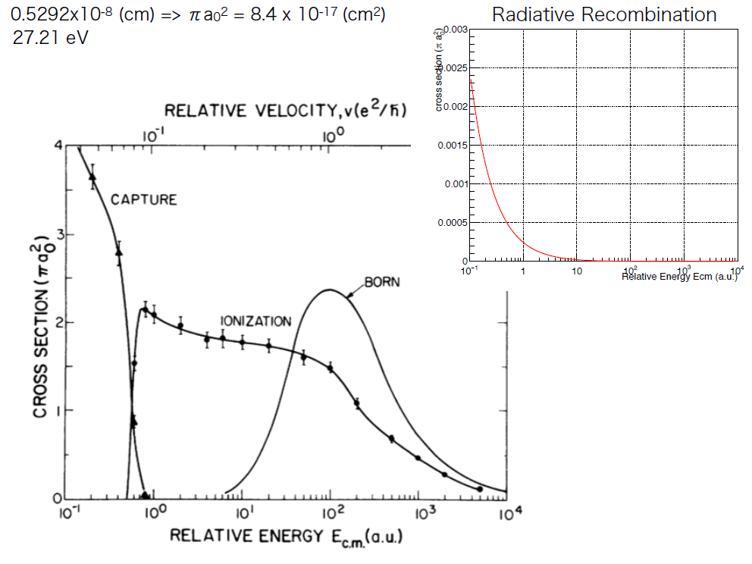
Slowing down and capture of negative muons by hydrogen: Classical-trajectory Monte Carlo calculation : muon energy 3 eV to 150 keV μ- + H(1s) – μ⁻ + H(nl) -- μ⁻ + e- + H⁺ -- e⁻ + H_{μ}(nl)

Slide 29
衝突エネルギー(Coll. E) | 粒子・イオン(ion , μ-) | 入射エネルギー(E) | 入射ビーム強度(intensity) | エキゾチック原子収量(yield) | β(v/c) | cβτ (0.1μs)
100 eV | ⁴He⁺⁺ | 40.9 keV | 6 x10¹⁵x10⁻³ | ~0.2 /sec | 0.0046 | ~14 cm
 | μ- | 1 keV | 3.6x10⁷x10-³ |  | 0.0069
50 eV | ⁴He⁺⁺ | 39.0 keV | 6x10¹⁵x10⁻³ | ~2 /sec | 0.0045 | ~13.5 cm
 | μ- | 1 keV | 3.6x10⁷x10⁻³ |  | 0.0069

Slide 30
Muonic X-ray Doppler Shift Measurement with Channeling or Blocking
L = C β τ
Ion beam
Muonic atom ion
expanded
Negative muon beam

Slide 31
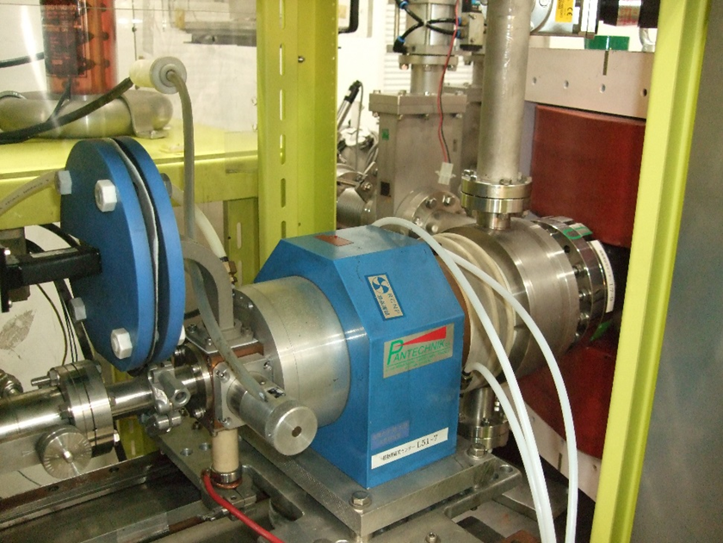

Slide 32
Doppler shift
Doppler shift
Doppler shift
E-x-ray
E-x-ray
E-x-ray
T_{1/2}
1 ps
10 ps
100 ps

Slide 33
Cyclotron natural bunch
10 ns ~ 100ns

Slide 34
High Resolution Si(Li) X-ray Detector
Beam Dump
Anal Magnet
Negative Muon Beam
Monitor
Thin Foils
Electro-static electrodes
Crystal
Si(Li)
Detector
MCP
Capillary
Ultra High Vacuum System
Ion Beam (p, d, 3He, 4He, 12C, 14N, 20Ne)

Slide 35
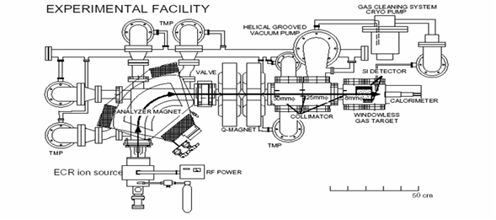


4- Low energy accelerator Project ( LEAP 1 )
Carbon foil
Helium gas
Hydrogen gas
ECR plasma
differential pumping is available
>100 μA
10 khz
just completed
FRESH → LEMANM

Slide 36
Summary and perspective
5 years project
減速化の基礎課程 basic for deceleration
粒子衝突の素過程 collision process
合流型の実験 merging
ミューオニック X-線の測定 muonic X-ray meas.
Auger 電子の測定 Auger electron meas.
脱励起過程の時間微分 time differential
ｐｓ から μs 領域へ pico sec. to μsec.
エキゾチック原子（μ＋μ－）への道 the long way

