Slide 1
Calculation of detector acceptance for measuring muon lifetime in MuSIC beam test by GEANT4
Kuno-Group D1
Nguyen Duy Thong

Slide 2
Outline
Introduction
Results
Summary

Slide 3
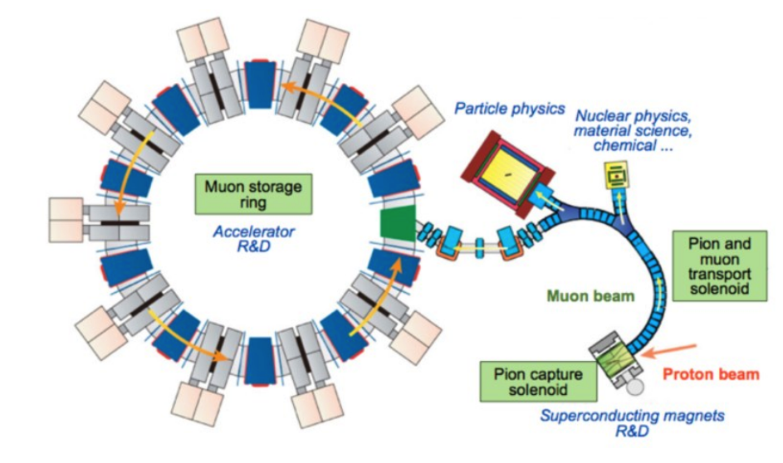
Introduction
MuSIC facility

Slide 4
The process in MuSIC facility:
At first, protons are accelerated in the MuSIC facility.
Then, they will impact with a target to produce π⁺ or π–.
μ⁺, μ– are emitted in π⁺, π– in the decay process.
Last, particles will be detected by detector.

Slide 5
muon
pion
detector
target
proton
Particles (μ⁺, μ–) are detected by a detector with 2 scintillators and 1 target.

Slide 6
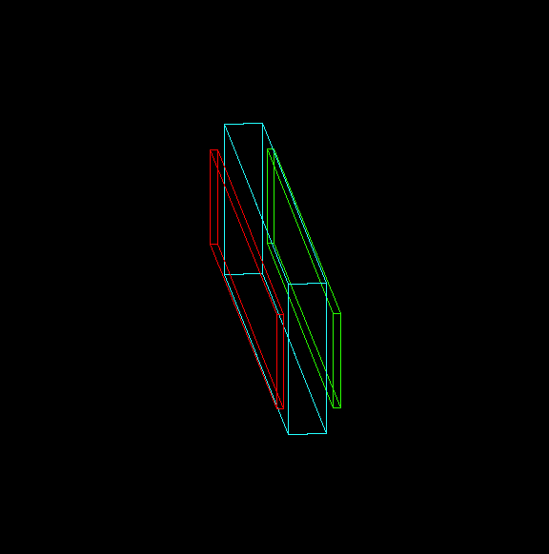
The detector consists of 2 scintillators and 1 target.
2 scintillators have same size 380x50x3.5 mm³
Target is made of Mg.
The size of target: 370x80x20mm³

Slide 7
In this study, by using Geant4 simulation:
First, without using dipole magnetic-field(By=0T), the acceptance of detector is determined.
Using dipole magnetic-field (By = ±0.04T), evaluate the acceptances of detector.

Slide 8
Motivation
Evaluate efficiency of muon between beamline and captured muon.
Consider about detector acceptance. Detector acceptance is defined as ratio between number of detected e⁺ or e– and number of incident μ+ or μ–at detector.

Slide 9
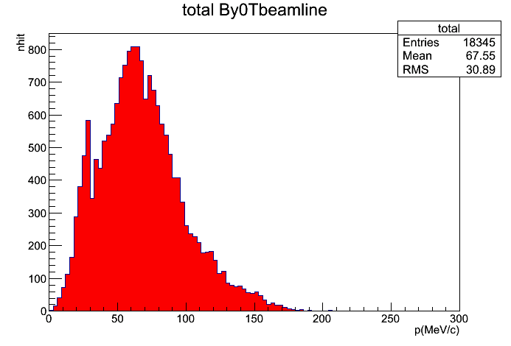
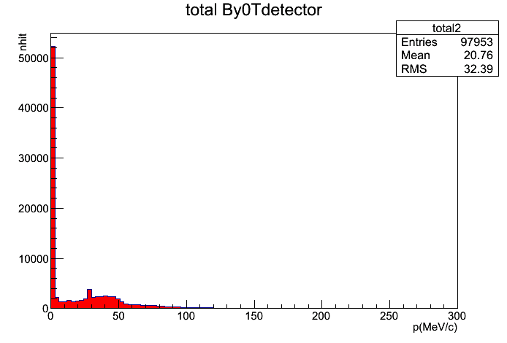
Results
For By=0T,

Slide 10
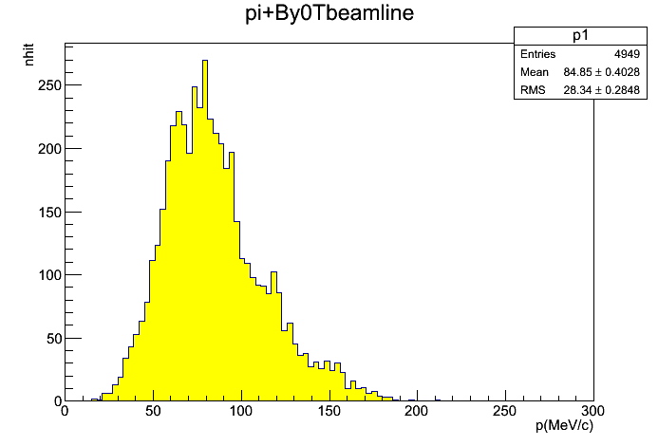
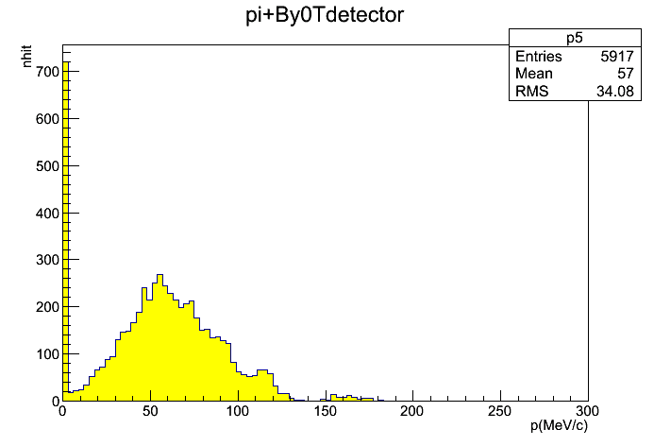
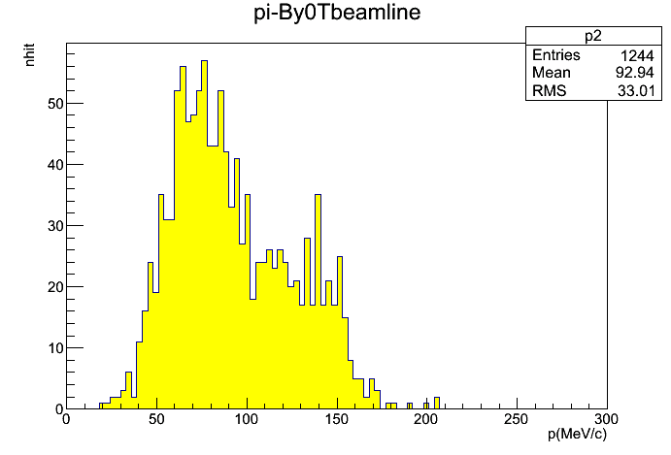
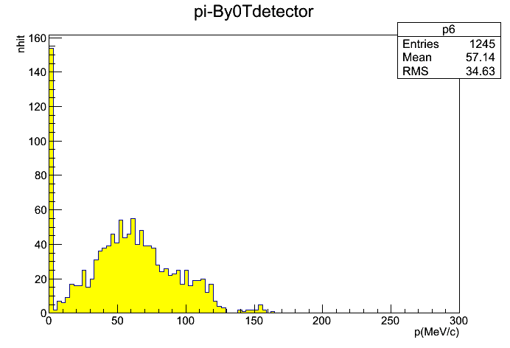

Slide 11
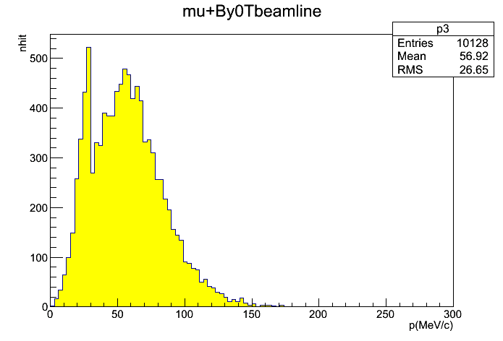
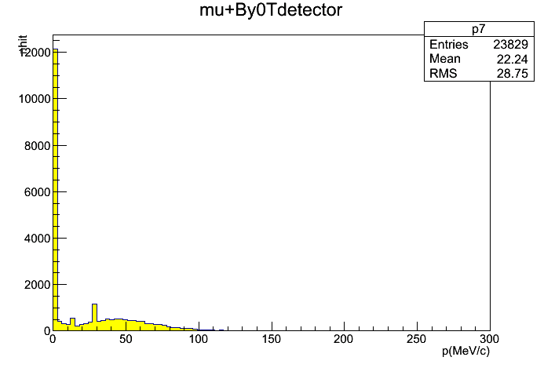
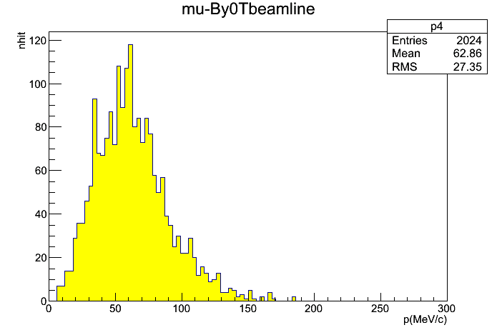
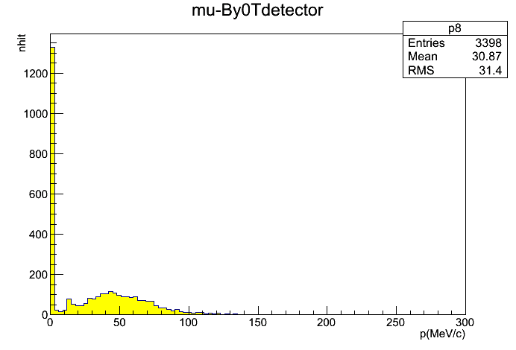

Slide 12
0.1μA-proton beam impacts with target, from Geant4, some results were calculated
 | Beamline | Sci 1 | Sci 2
π＋ | 4949 | 663 | 187
π^{ー} | 1249 | 130 | 38
μ＋ | 10128 | 1530 | 352
μ^{ー} | 2024 | 277 | 68
e＋ | 0 | 335 | 212
e^{ー} | 0 | 335 | 329
The efficiency of μ

Slide 13
The detector acceptance

Slide 14
For By=+0.04T
 | Beamline | Sci 1 | Sci 2
π＋ | 1957 | 222 | 46
π^{ー} | 1550 | 315 | 125
μ＋ | 5461 | 690 | 149
μ^{ー} | 2306 | 402 | 131
e＋ | 0 | 441 | 274
e^{ー} | 0 | 382 | 219
The efficiency of μ

Slide 15
The detector acceptance

Slide 16
For By=–0.04T
 | Beamline | Sci 1 | Sci 2
π＋ | 7745 | 1232 | 400
π^{ー} | 545 | 57 | 10
μ＋ | 13073 | 2158 | 564
μ^{ー} | 1248 | 139 | 26
e＋ | 0 | 1269 | 847
e^{ー} | 0 | 709 | 363
The efficiency of μ

Slide 17
The detector acceptance

Slide 18
Summary
In this research, with 0.1μA-proton beam, numbers of π⁺,π–,μ⁺,μ–,e⁺,e^{ー} were estimated
The detector acceptances were calculated.
Next step
Some features need to be improved to ensure simulation better.

Slide 19
Thank you for your attention

Slide 20
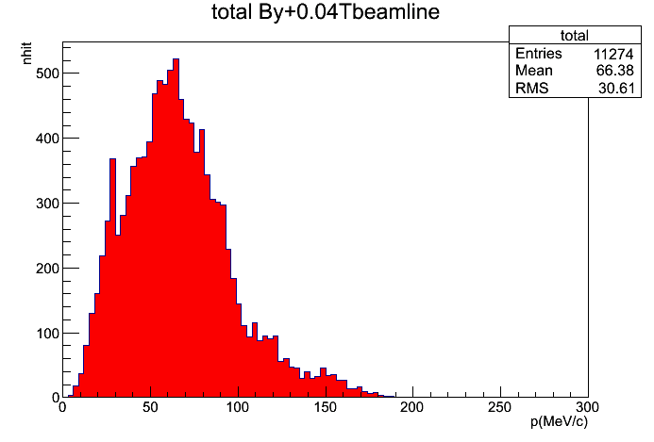
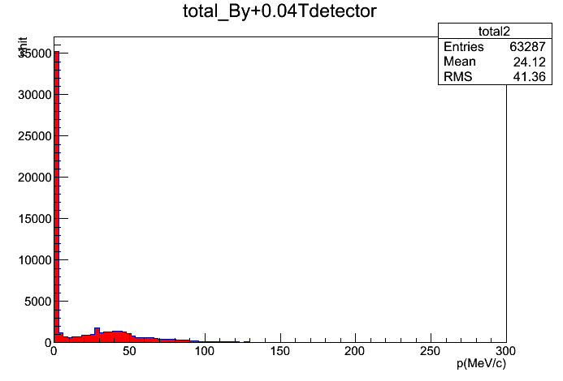
Backup

Slide 21
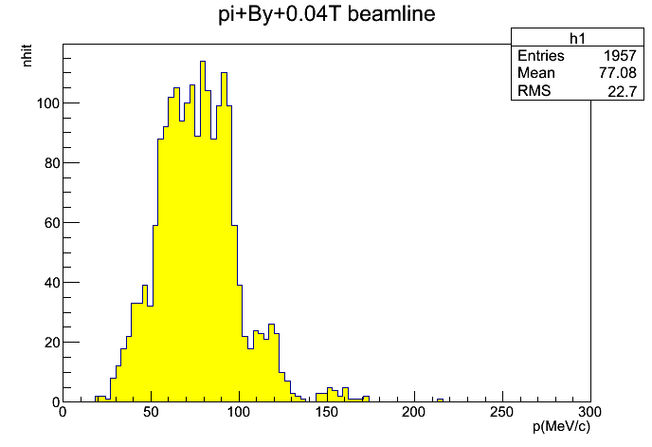
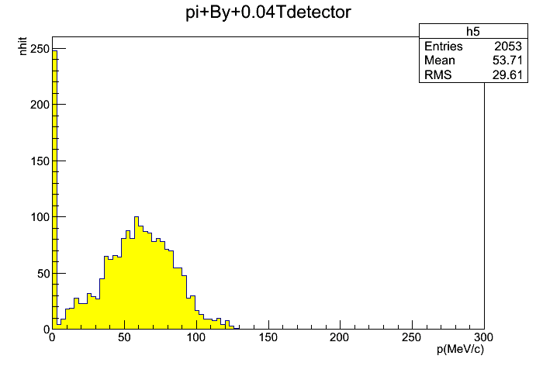
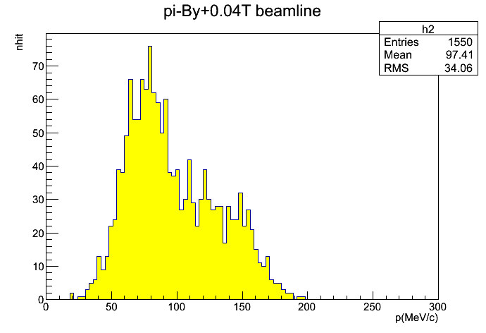
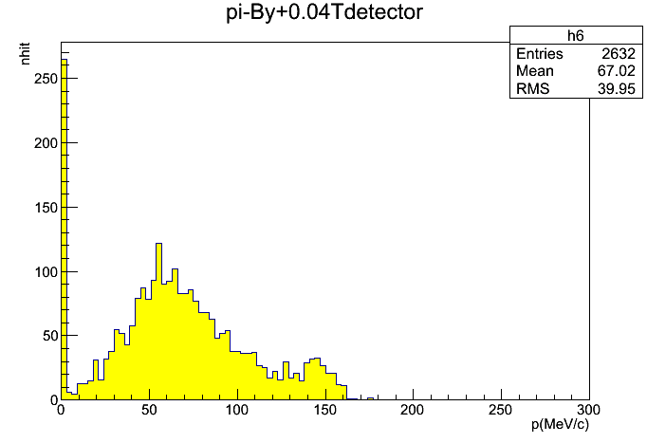

Slide 22
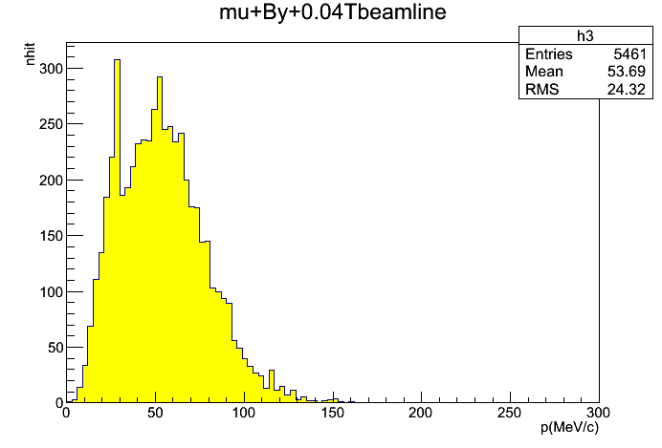
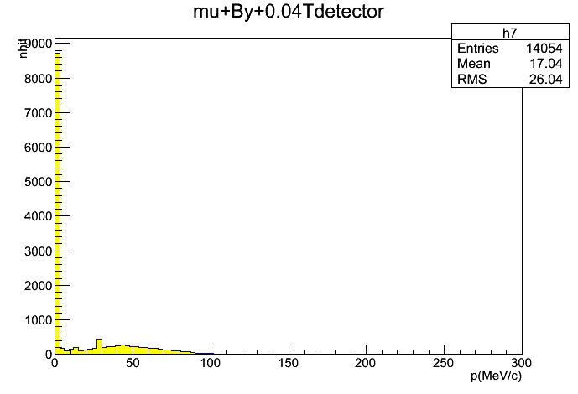
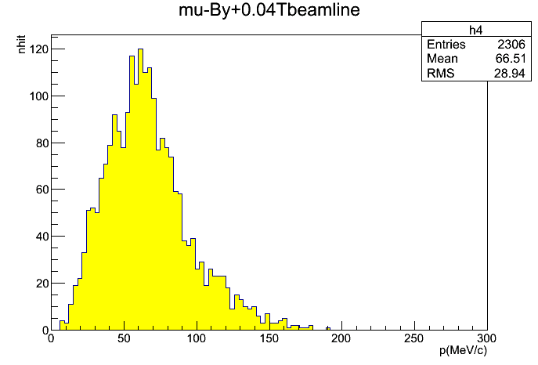
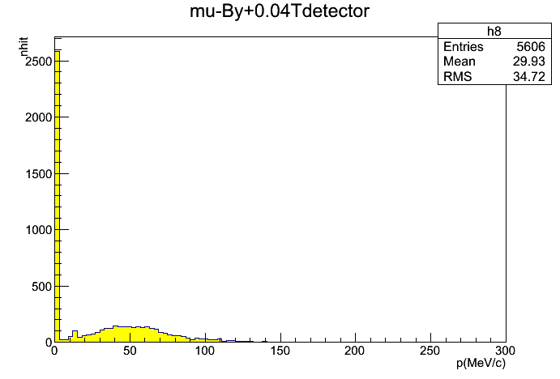

Slide 23
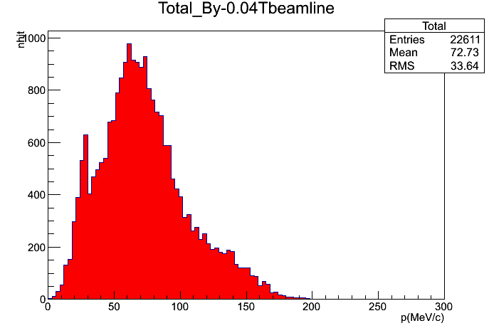
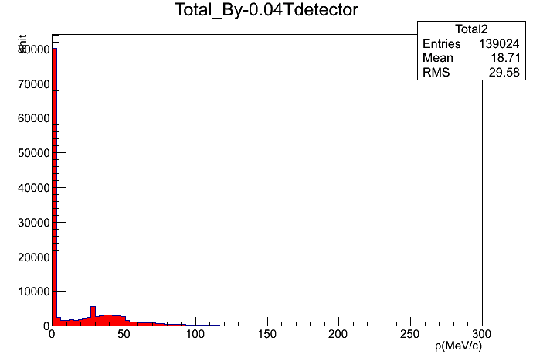

Slide 24
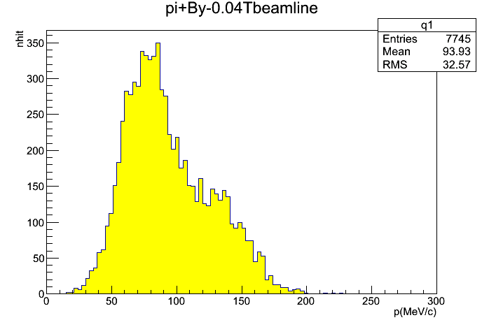
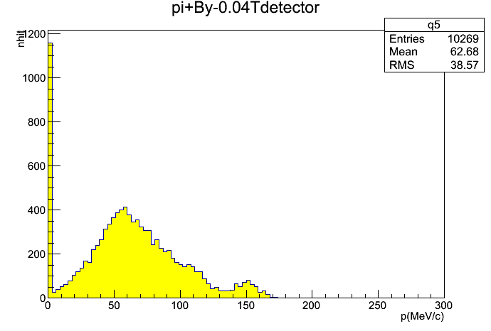
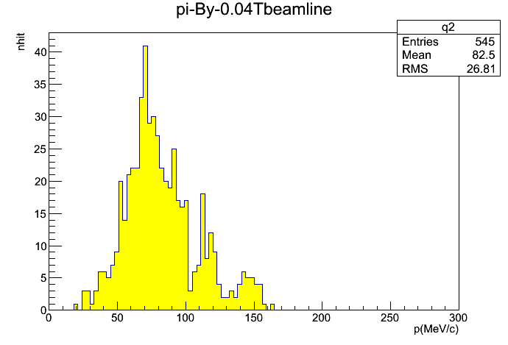
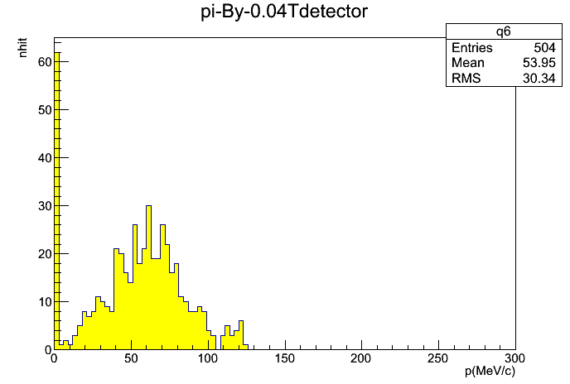

Slide 25
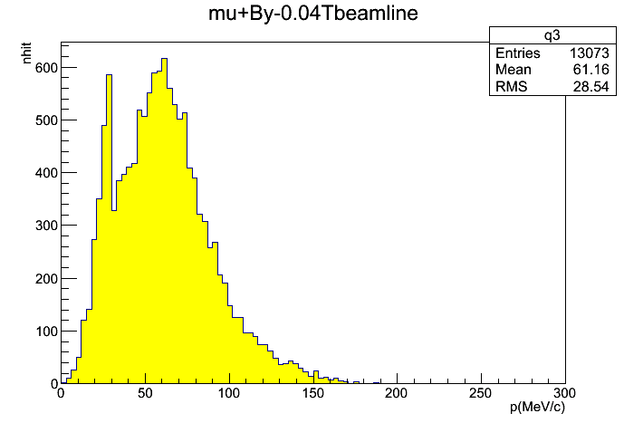
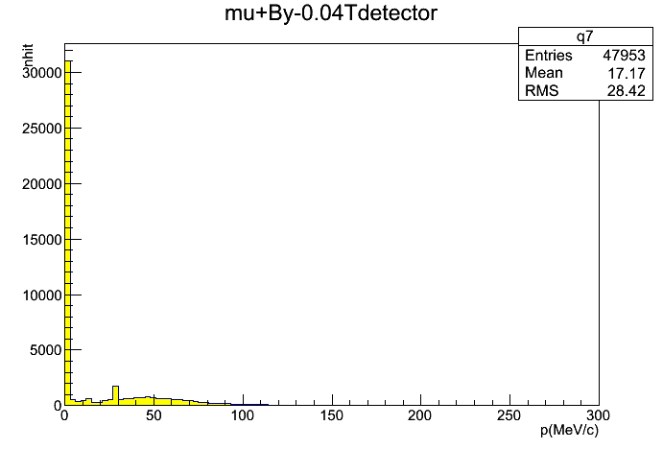
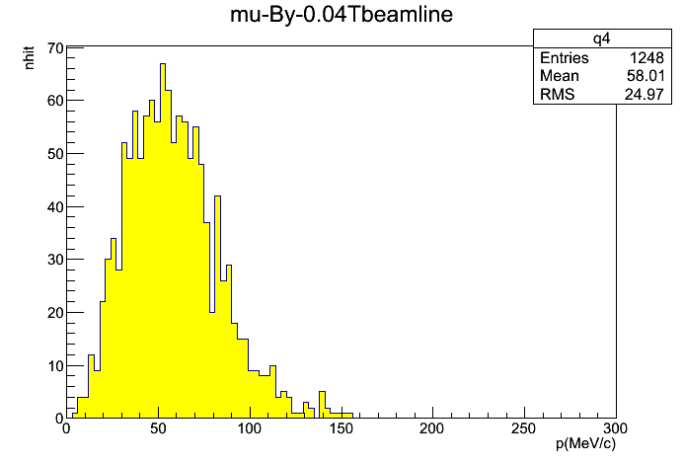
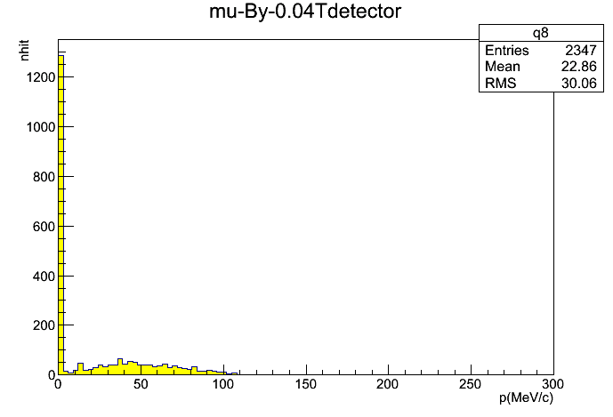

Slide 26
By = 0T | Beamline | Sci 1 | Stop at Sci1 | Sci 2 | Stop at Sci2
π＋ | 4949 | 663 | 44 | 187 | 34
π^{ー} | 1249 | 130 | 16 | 38 | 7
μ＋ | 10128 | 1530 | 444 | 352 | 73
μ^{ー} | 2024 | 277 | 43 | 68 | 12
e＋ | 0 | 335 | 16 | 212 | 5
e^{ー} | 0 | 335 | 0 | 329 | 0

Slide 27
By=+0.04T | Beamline | Sci 1 | Stop at Sci 1 | Sci 2 | Stop at Sci 2
π＋ | 1957 | 222 | 16 | 46 | 13
π^{ー} | 1550 | 315 | 9 | 125 | 10
μ＋ | 5461 | 690 | 188 | 149 | 36
μ^{ー} | 2306 | 402 | 50 | 131 | 11
e＋ | 0 | 441 | 4 | 274 | 3
e^{ー} | 0 | 382 | 0 | 219 | 0

Slide 28
By= ー0.04T | Beamline | Sci 1 | Stop at Sci1 | Sci 2 | Stop at Sci 2
π＋ | 7745 | 1232 | 73 | 400 | 27
π^{ー} | 545 | 57 | 4 | 10 | 1
μ＋ | 13073 | 2158 | 496 | 564 | 90
μ^{ー} | 1248 | 139 | 34 | 26 | 2
e＋ | 0 | 1269 | 14 | 847 | 9
e^{ー} | 0 | 709 | 0 | 363 | 0

